Slide 1
Event Management Application
By
Roja Gone

Slide 2
AGENDA
Introduction
Scope
Objective and Benefits
Limitation
Software Engineering Model
Features Enhancement
Security
Interface
References

Slide 3
Introduction
This Project Event Management System has been developed by Android Studio, Technology used Android and Firebase Database.
We are using java language in this project.
Event Management Application is to provide fast services to their customers. They can easily find shops with available budget for their events.
This application will provide the list of different shop list with shop image/logo. Customer can select any shop then it will show all available services like wedding package, Birthday package etc.
There are shows available designs with image and price for events in that services.
Customer have to register with valid details and They can login by using google
In shop details we provide shop all details so Customer can communicate with vendor through phone.
Vendor can register and login in Vendor Application. Also login by using google account when Admin approve the vendor otherwise vendor can not login.if vendor authorized then they can login.
In Vendor Application, the vendor can see their profile and all customer orders.

Slide 4
SCOPE
This application provides a way for online booking system by setting date and time as per user required .
- Application can able to provide simple way to customer.
- Application can able to provide the best security level to the users of the site for authenticate users online.
- Application have three roles they are Admin,Vendor and Customer.
- Application can able to manage Order System.
- Keep the records about old customer and vendor data for specific time period.
- Application gives the best way for the registration of new users .

Slide 5
Objective and Benefits
Event Management Application is simply the process of efficiently tracking and fulfilling orders .
To develop a system that will surely encourage the customers to easily order on time by using date and time feature.
The Event Management Application starts from when a customer places an order, to keeping track of that order until it is fulfilled.
The Event Management Application provide When customer order they should wait until vendor accept. If vendor accept or reject the customer get message in “My Events” option.
The Event Management Application provide after order if they want to cancel it is also available in “My Event” option.
In Vendor Application, vendor can accept and reject the orders.
The application stores all the messages and data in Firebase database.

Slide 6
Limitation
This application can not access duplicate email addresses.
Customer can login by using google account.
Application can access only one username by registration if u enter same username already used username then it gives alert message.

Slide 7
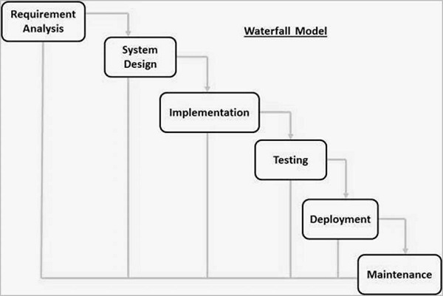
Software Engineering Model

Slide 8
Features Enhancement
User can not face the problem after using the website.
User will get regular update.
New design will make the website user friendly.
User can get message when their order is completed.

Slide 9
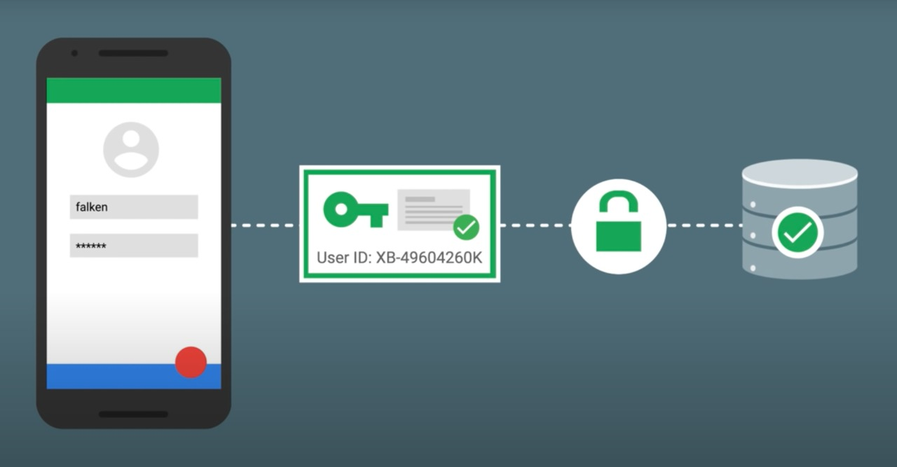
Security
Firebase will manage user session after successful login. so that users can remained logged in, to access other data from database

Slide 10
Security
Firebase gives you complete control over authentication by allowing you to authenticate users or devices using secure JSON Web Tokens (JWTs).
These JSON Web Tokens can be generated in two ways
Create JWT using default firebase method
Create custom JWT using a combination of sign-in credentials—such as a username and password

Slide 11
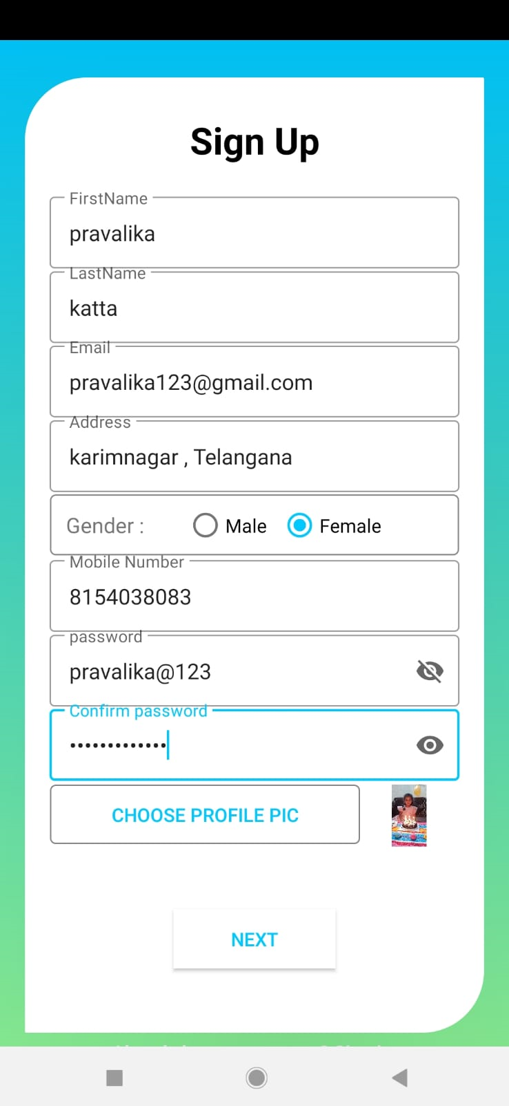
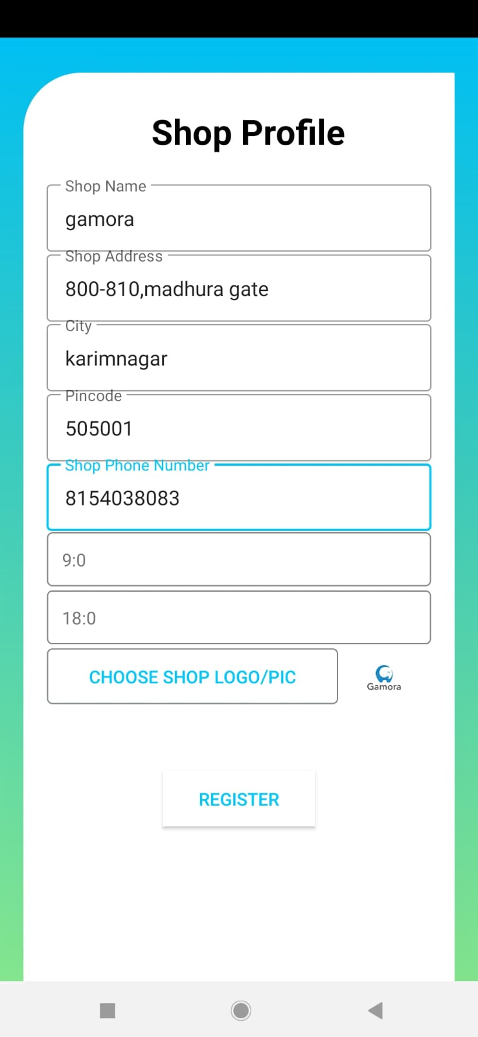
Interface design

Slide 12
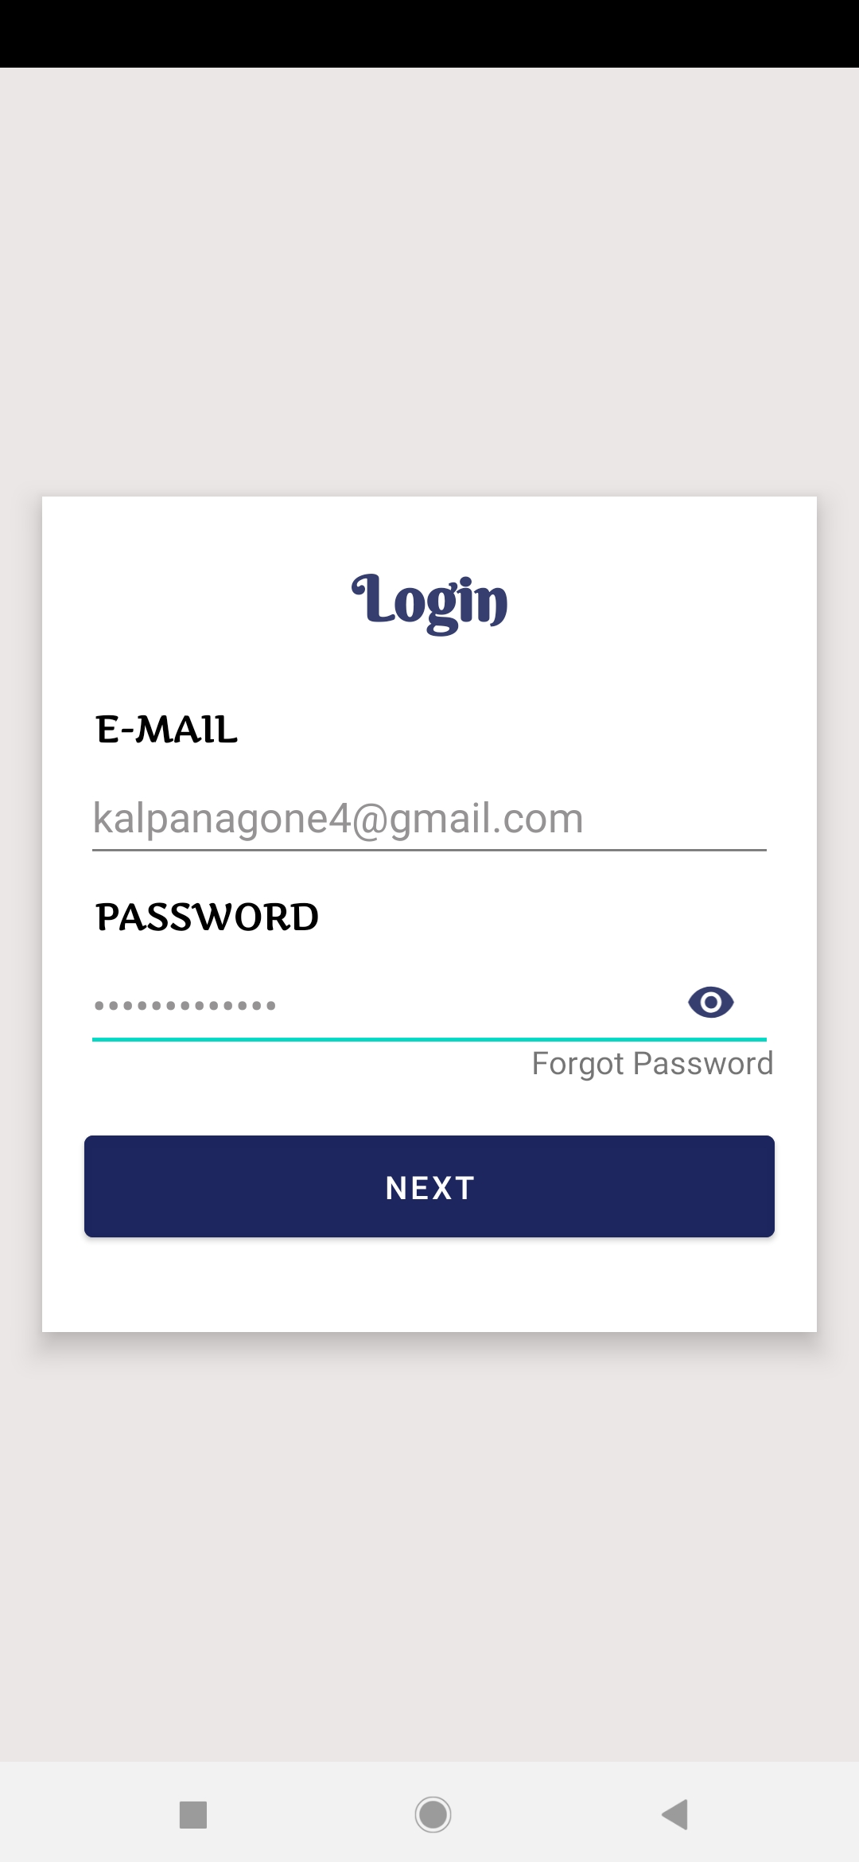
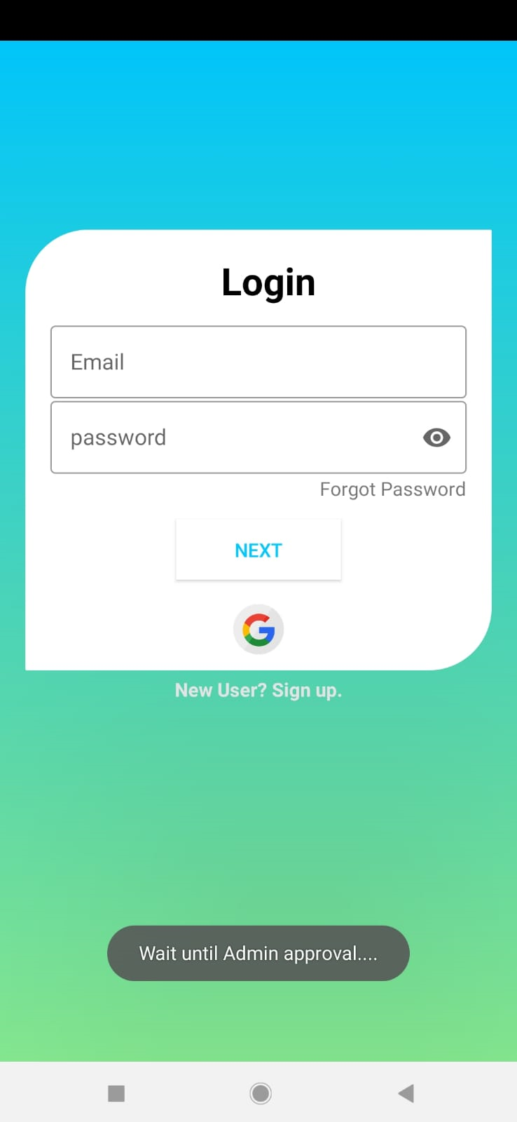

Slide 13
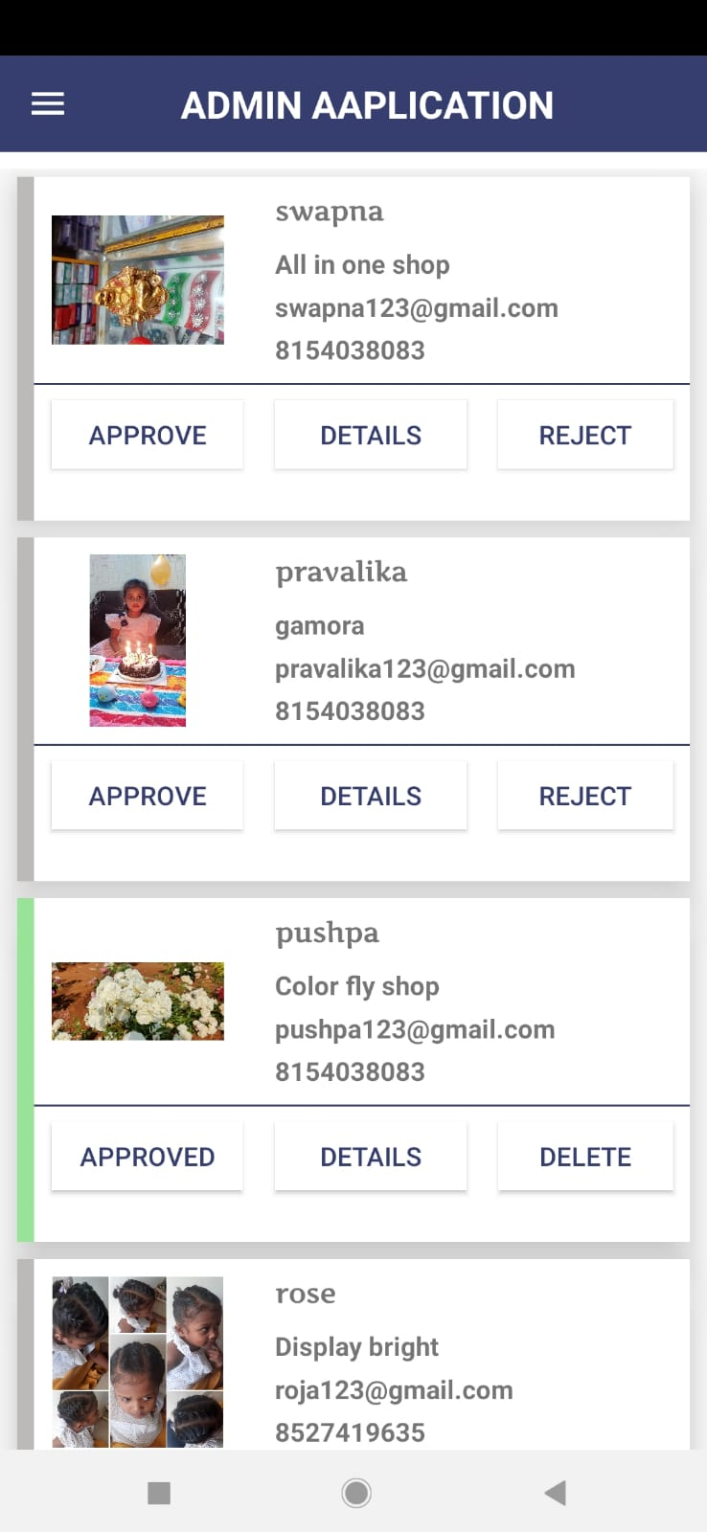
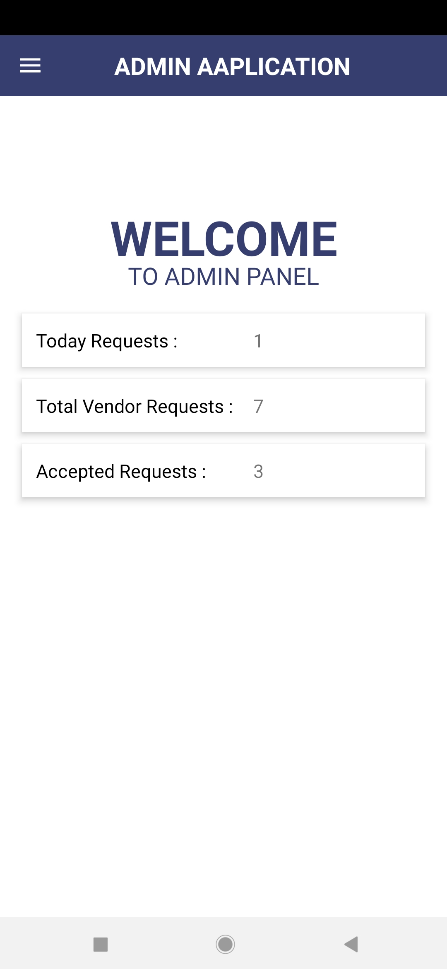

Slide 14
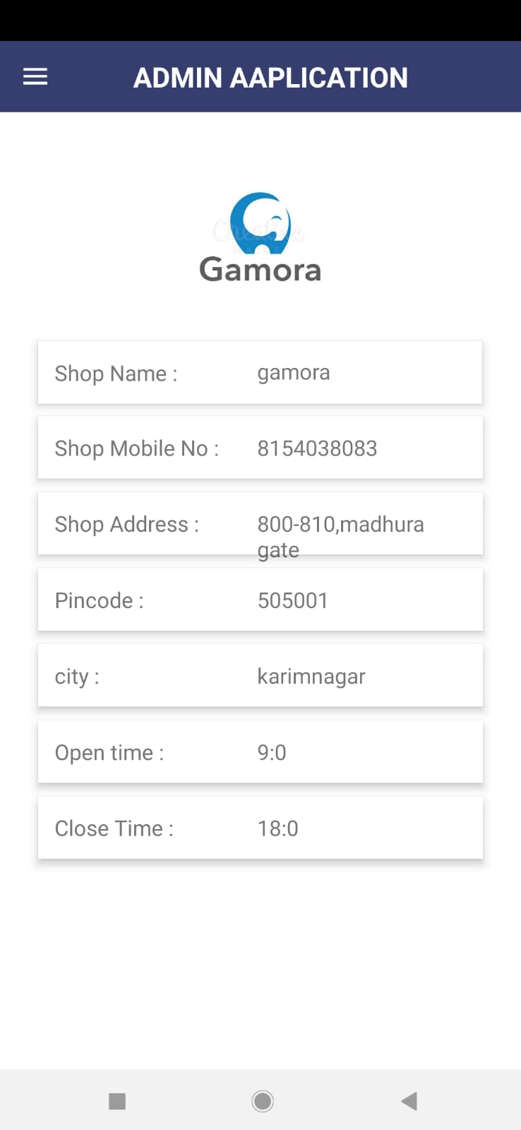
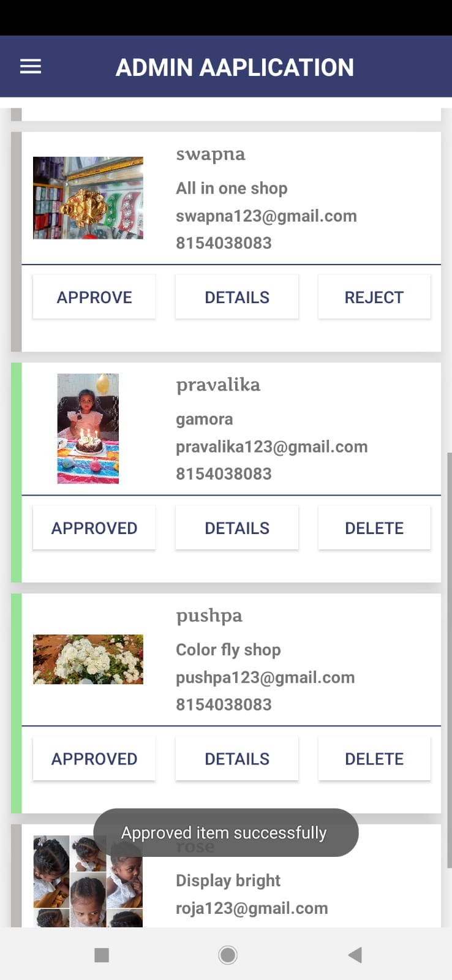

Slide 15
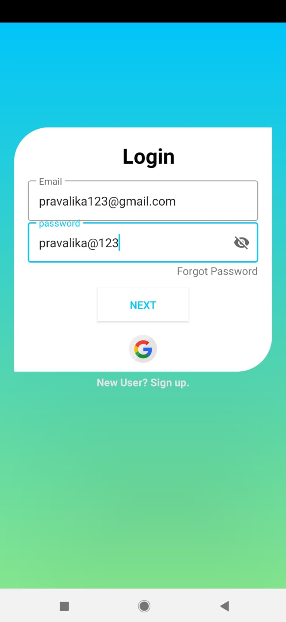
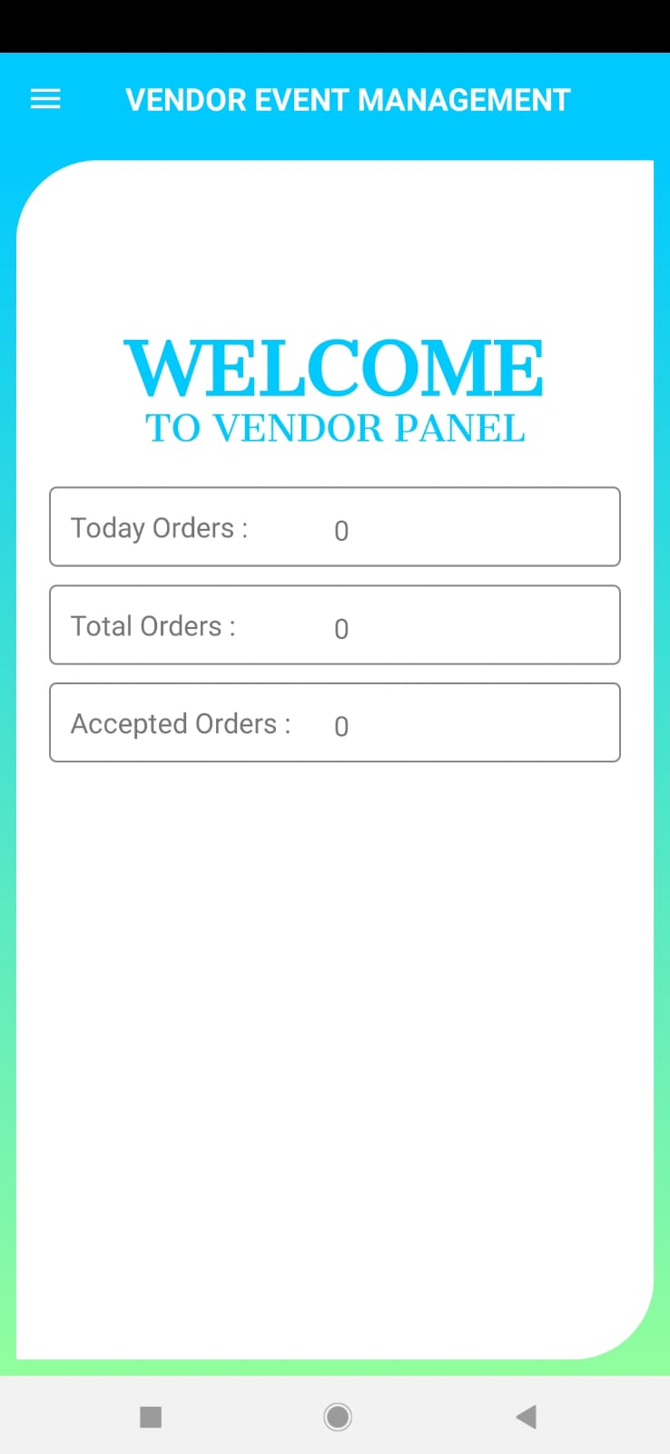

Slide 16
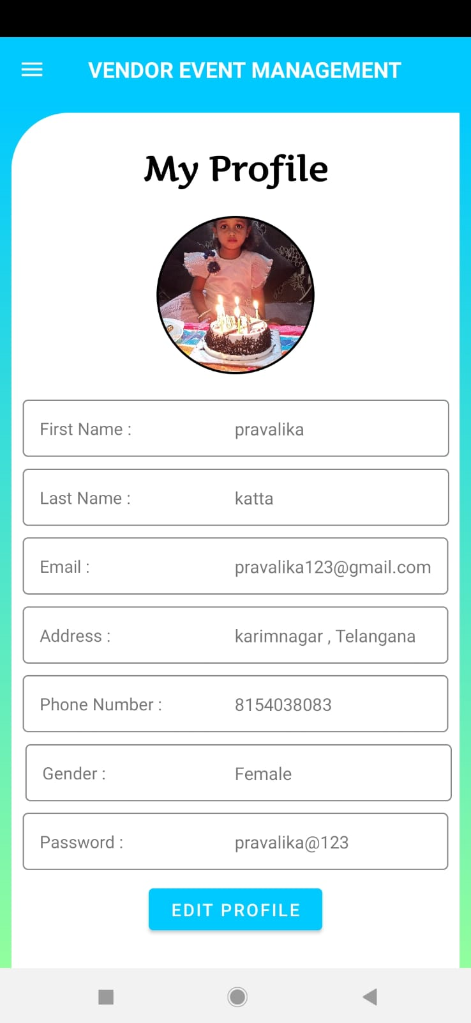
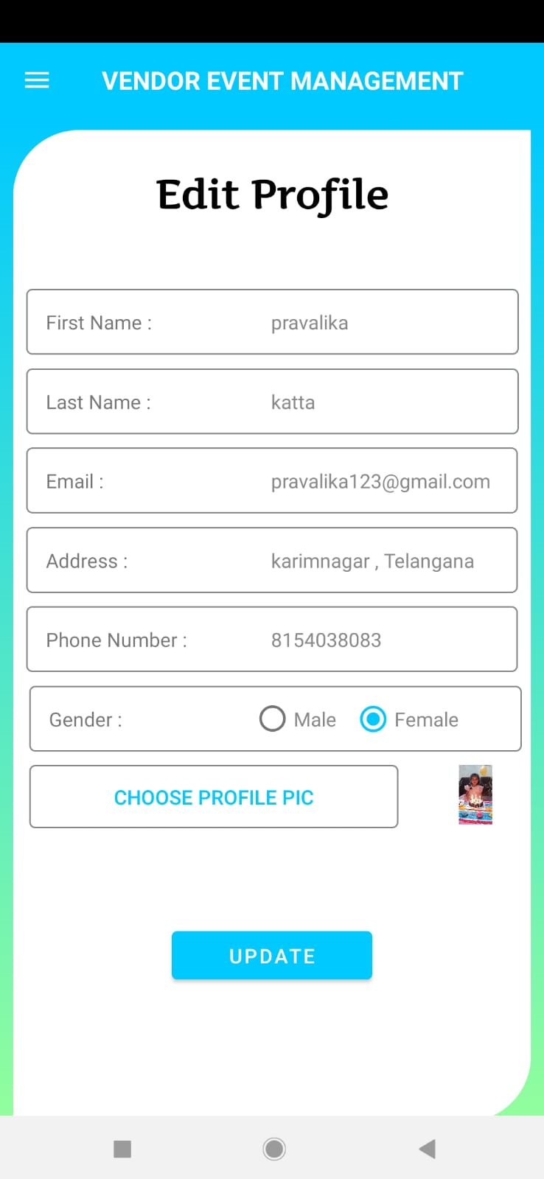

Slide 17
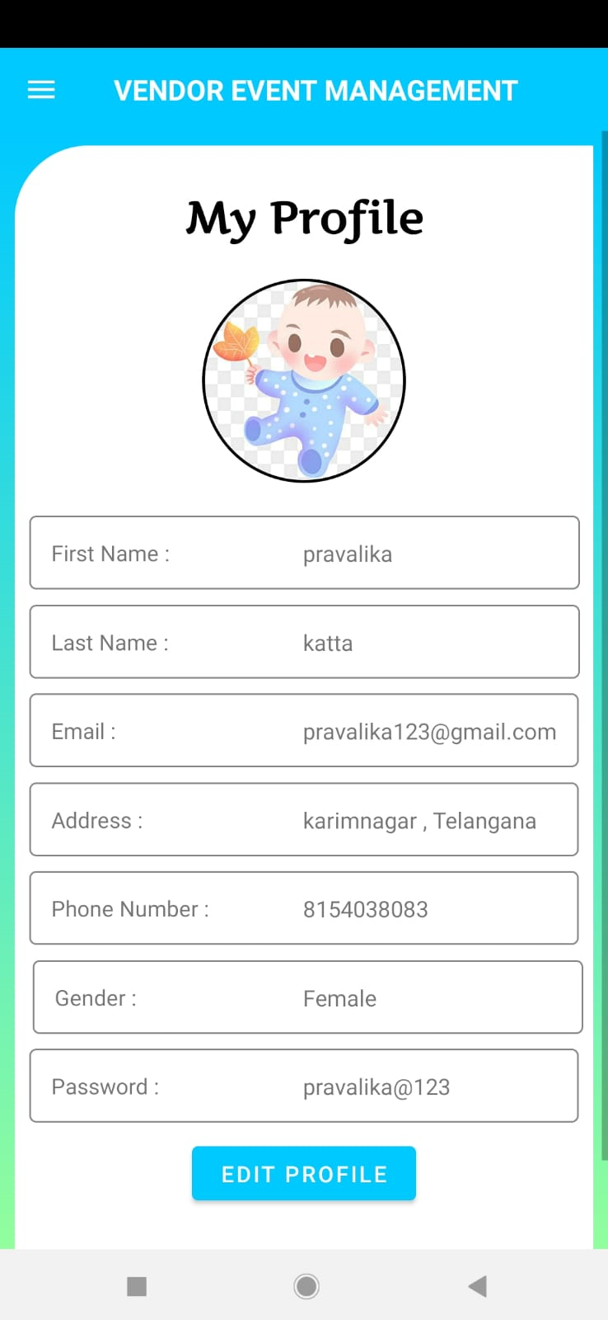
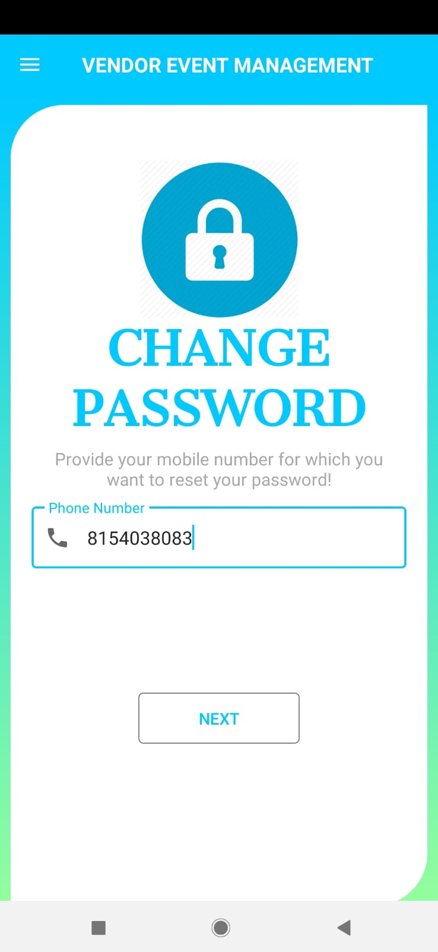

Slide 18
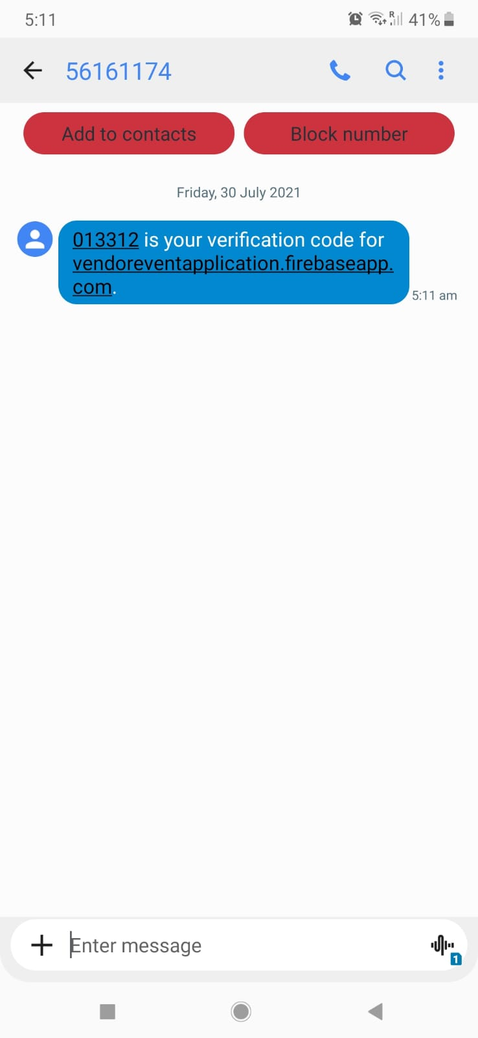
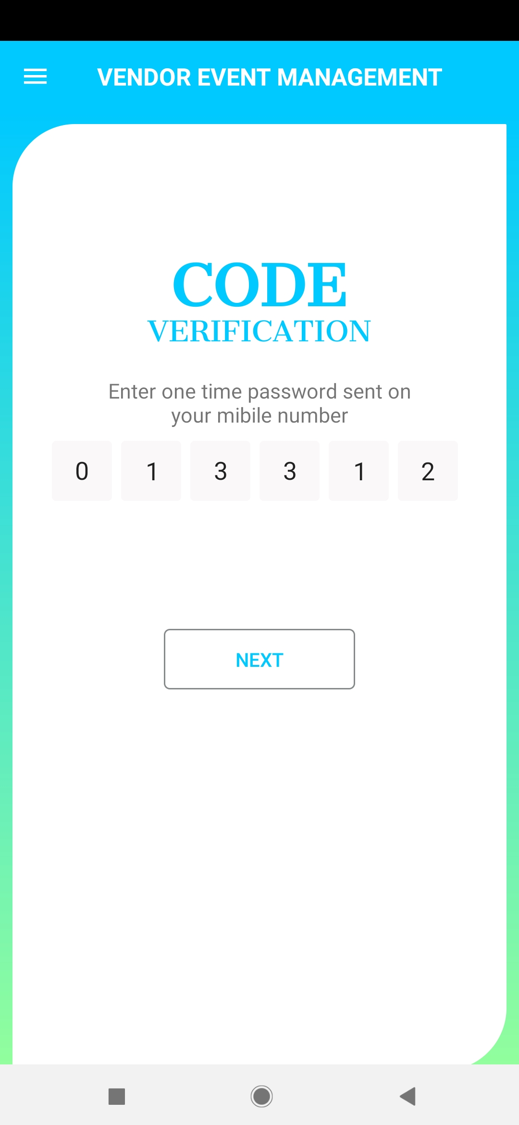

Slide 19
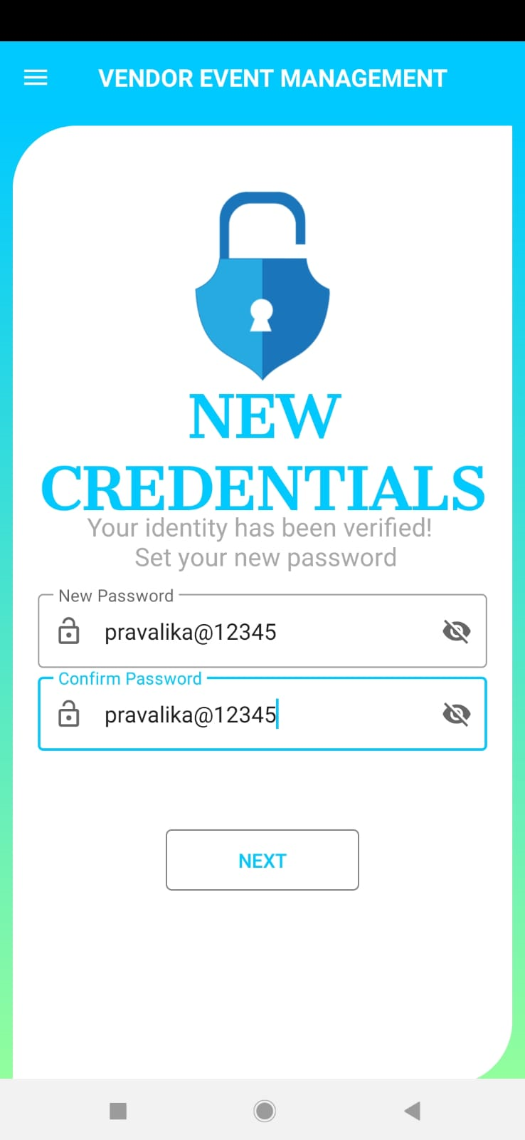
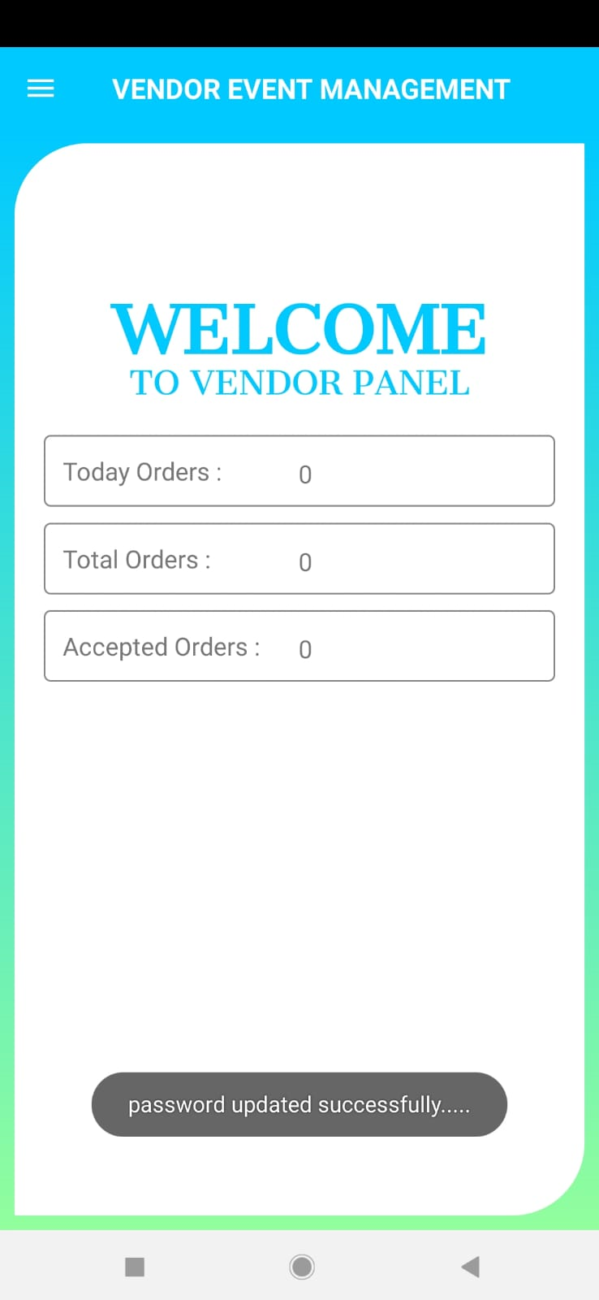

Slide 20
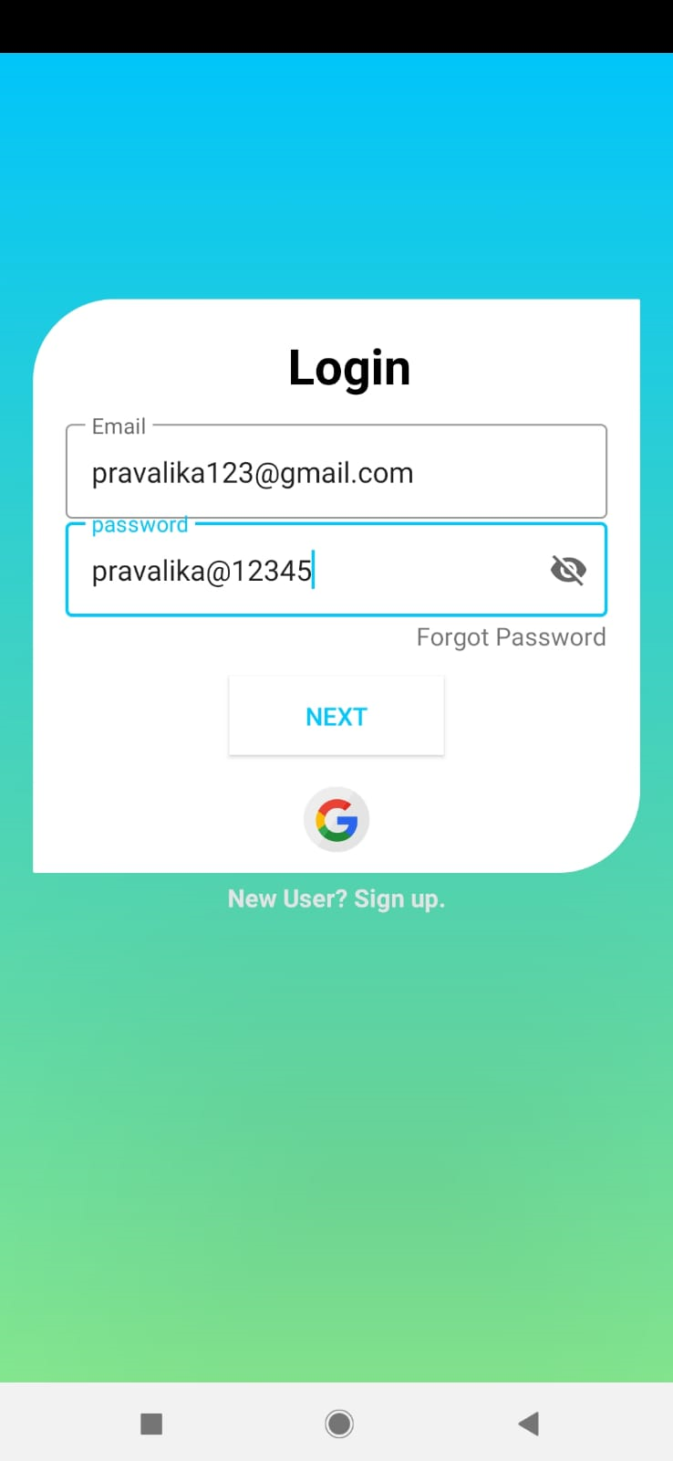
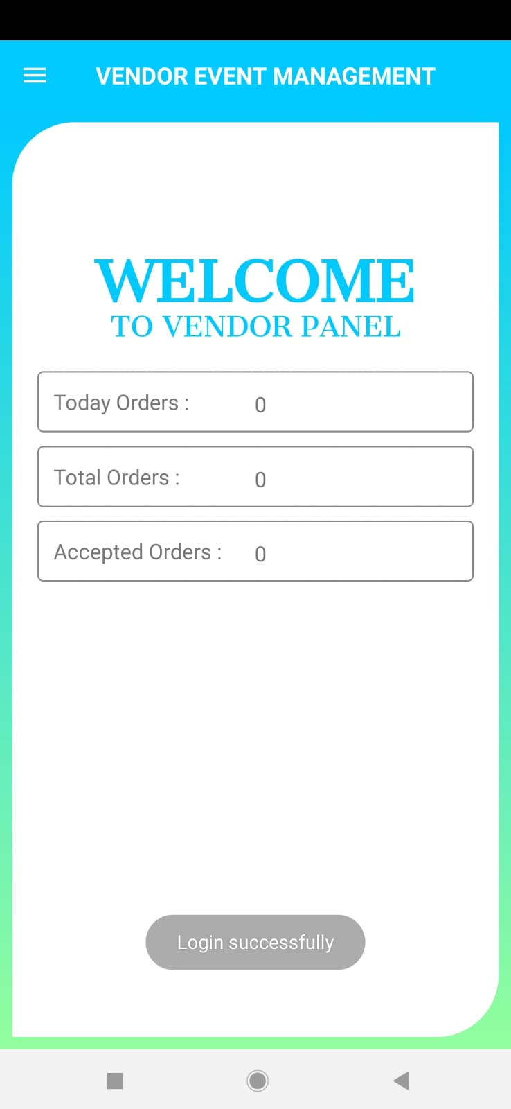

Slide 21
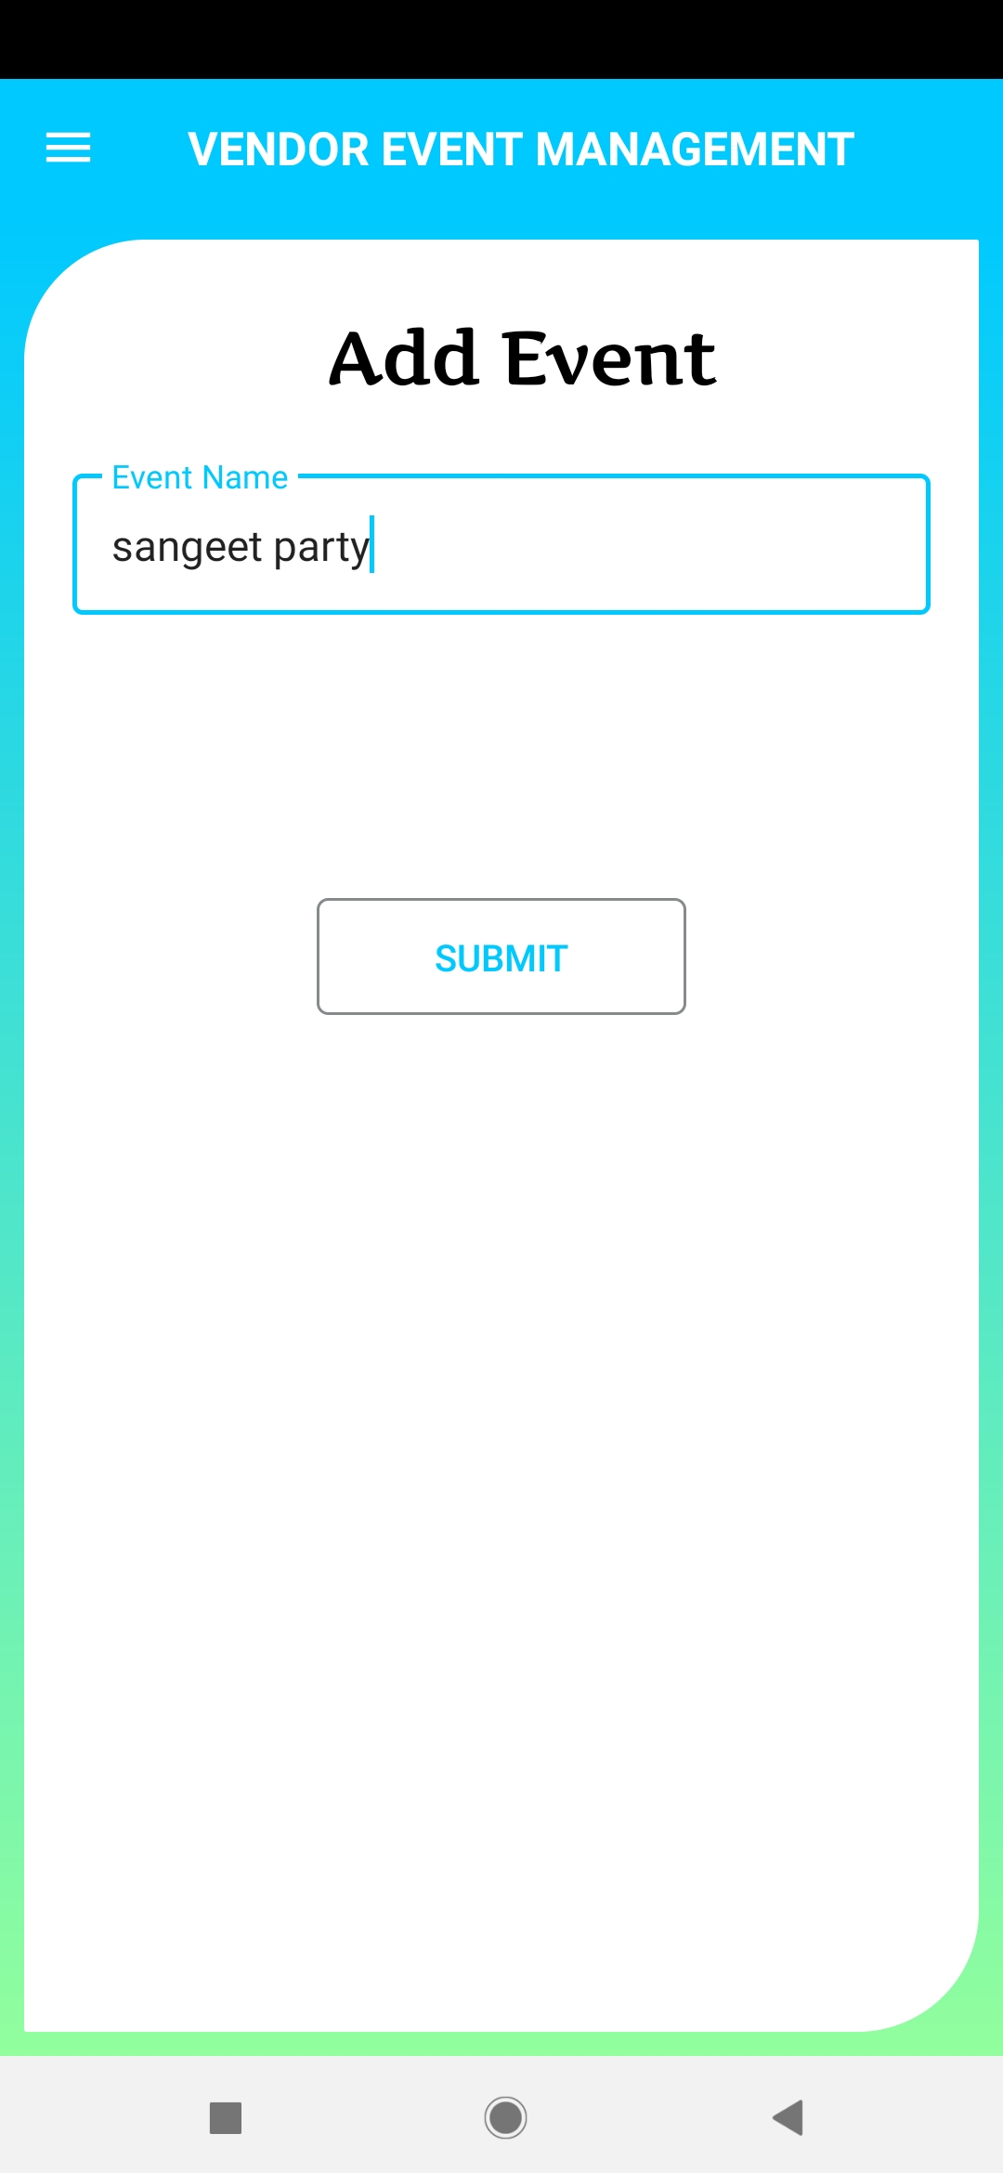
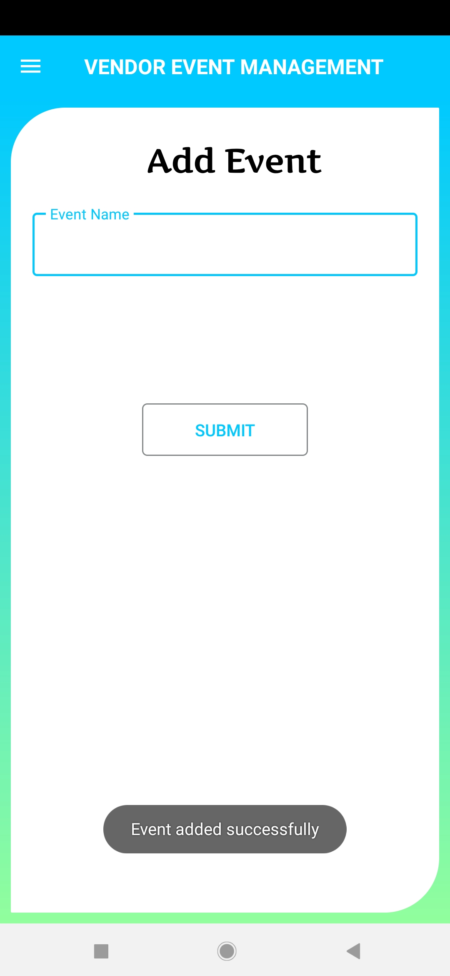

Slide 22
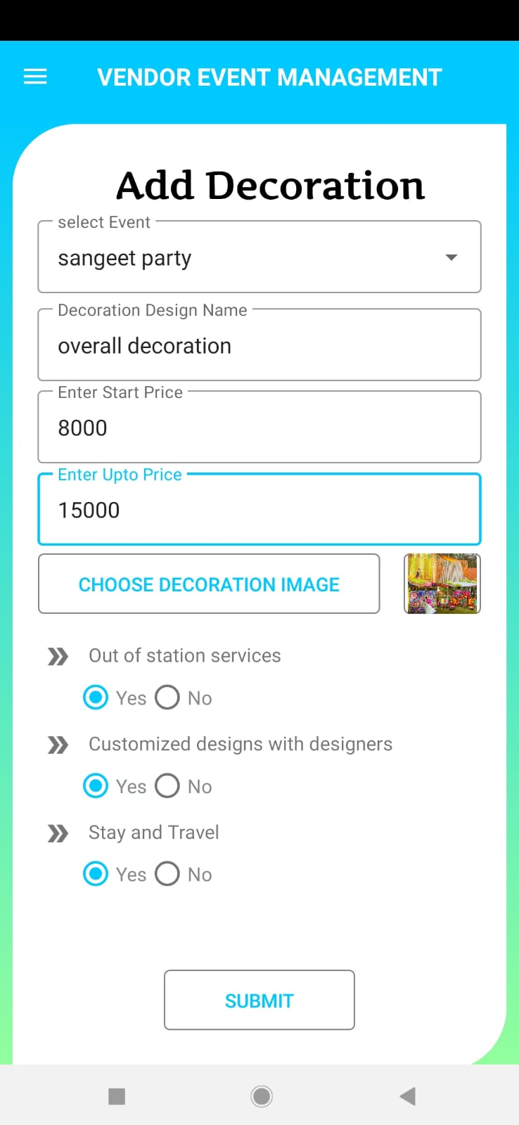
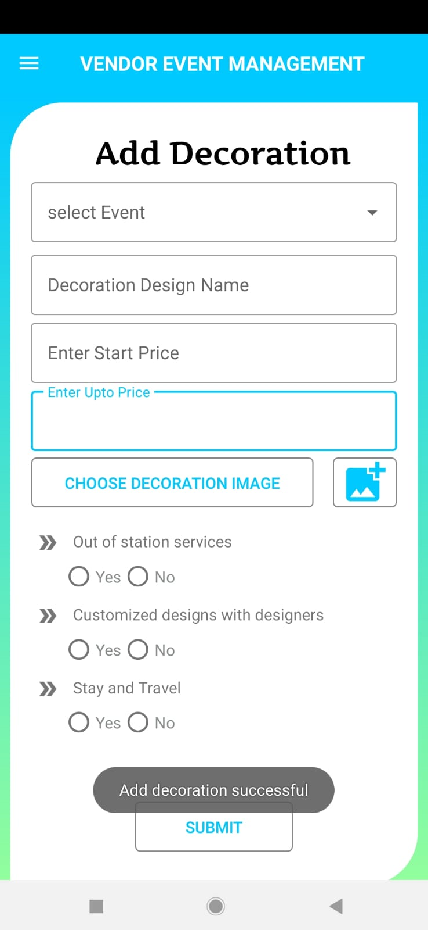

Slide 23
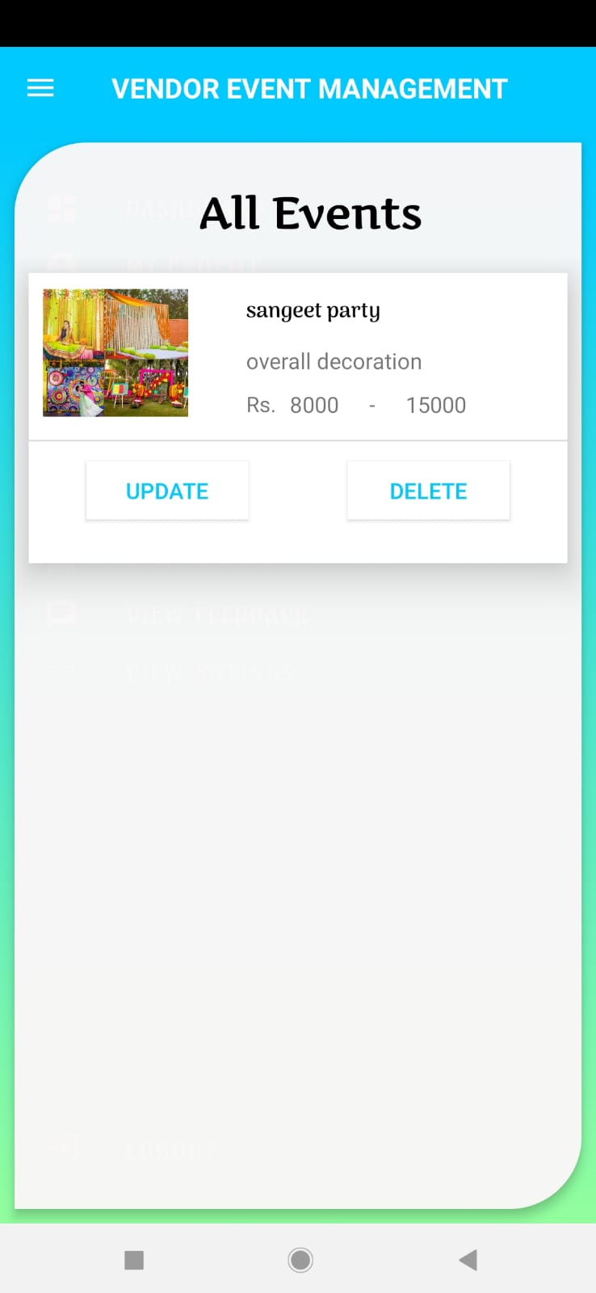
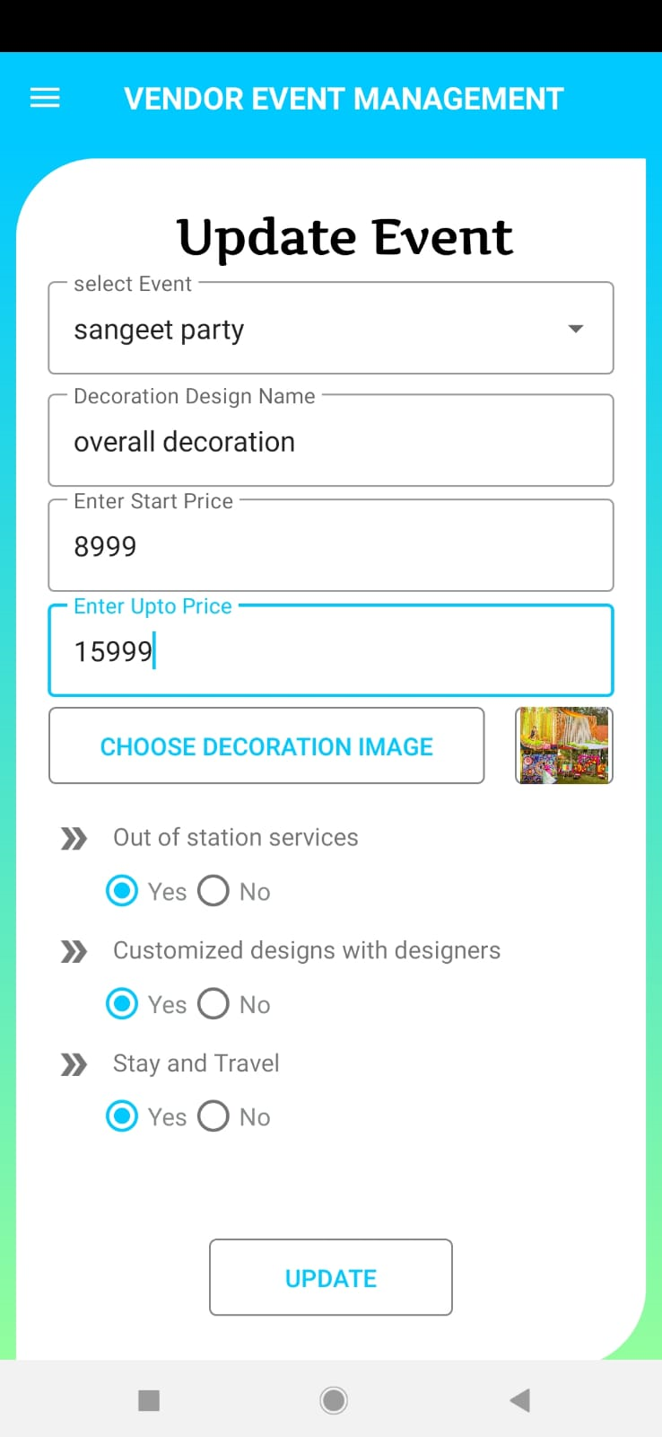

Slide 24

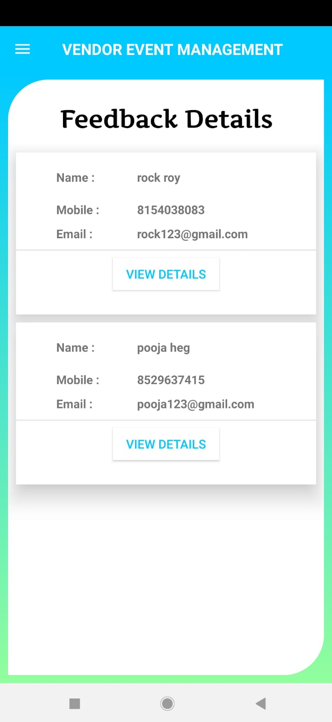

Slide 25
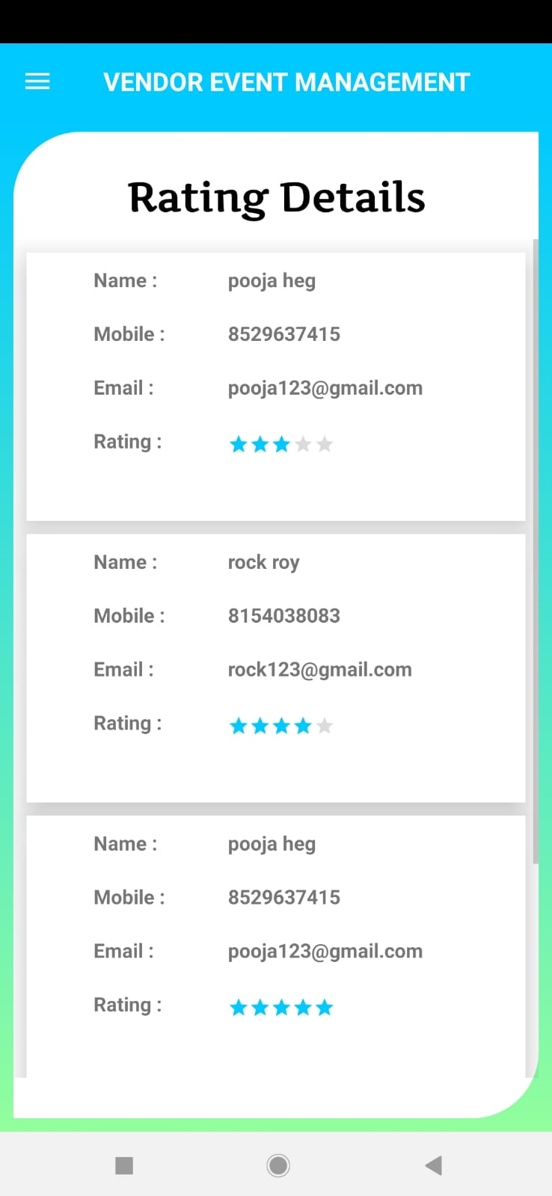
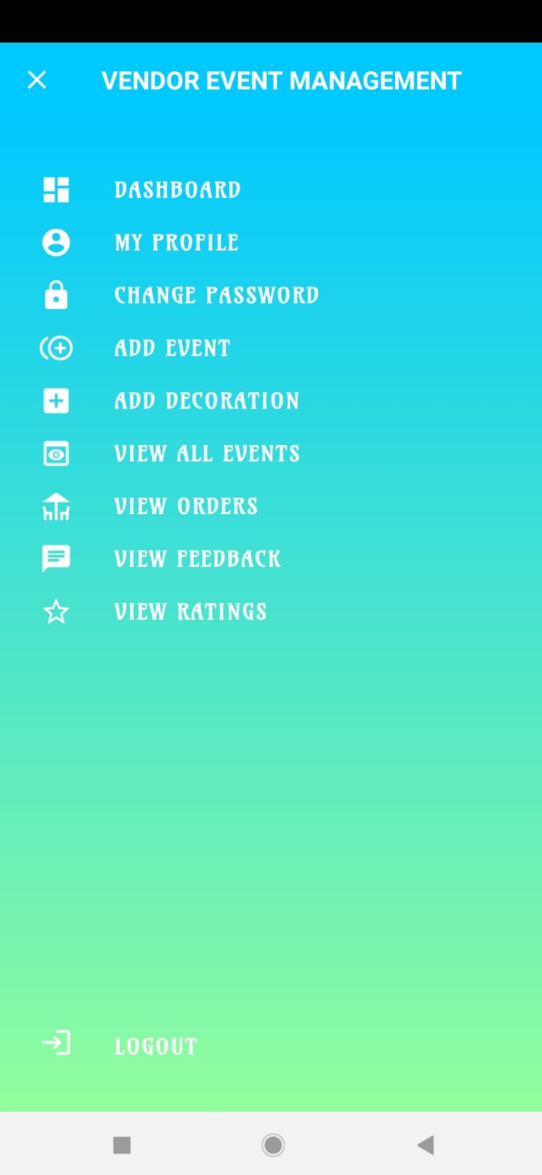

Slide 26
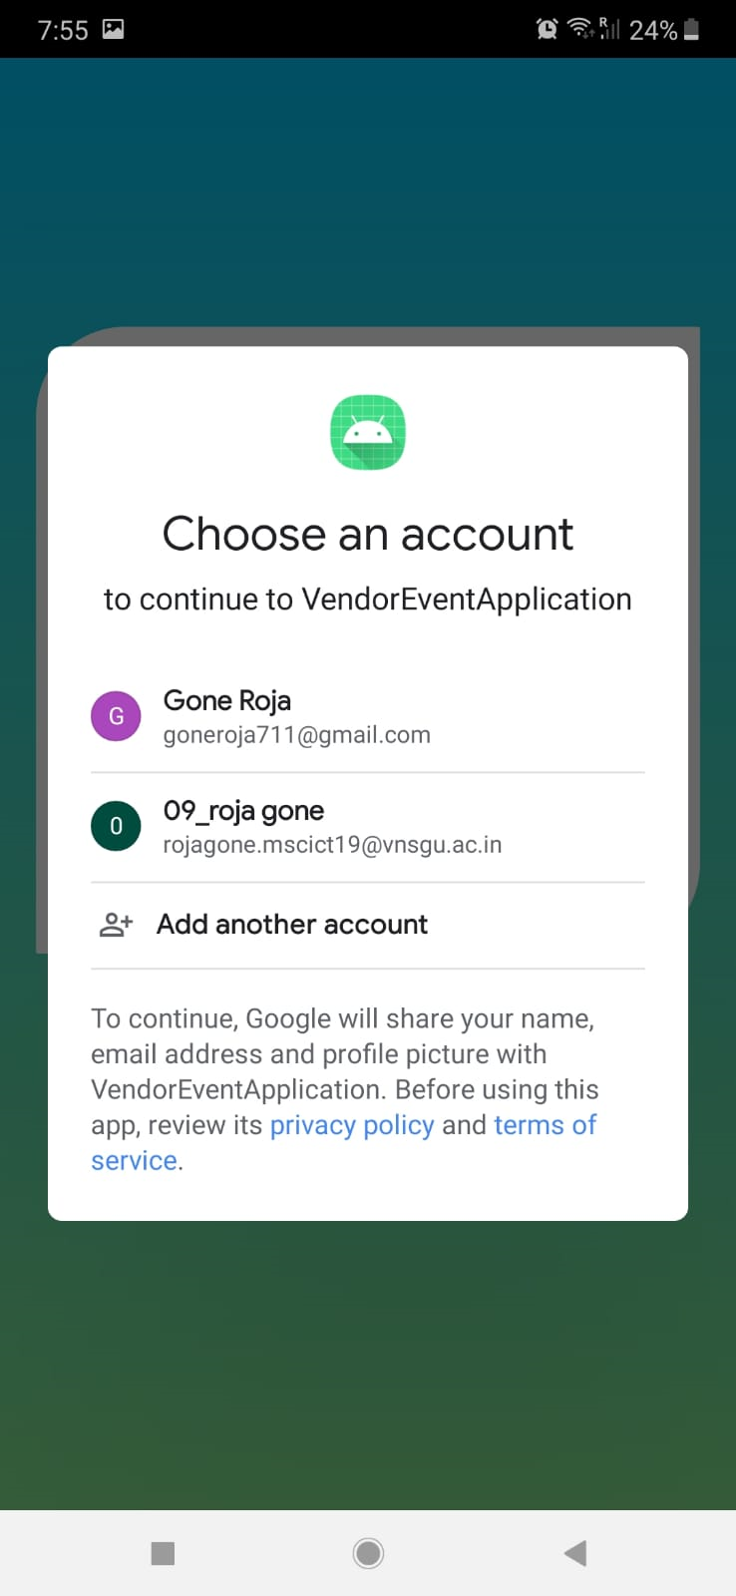
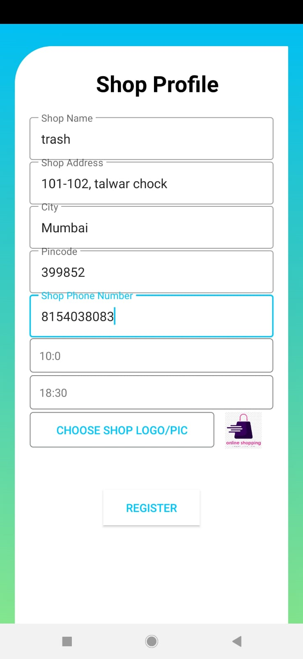

Slide 27
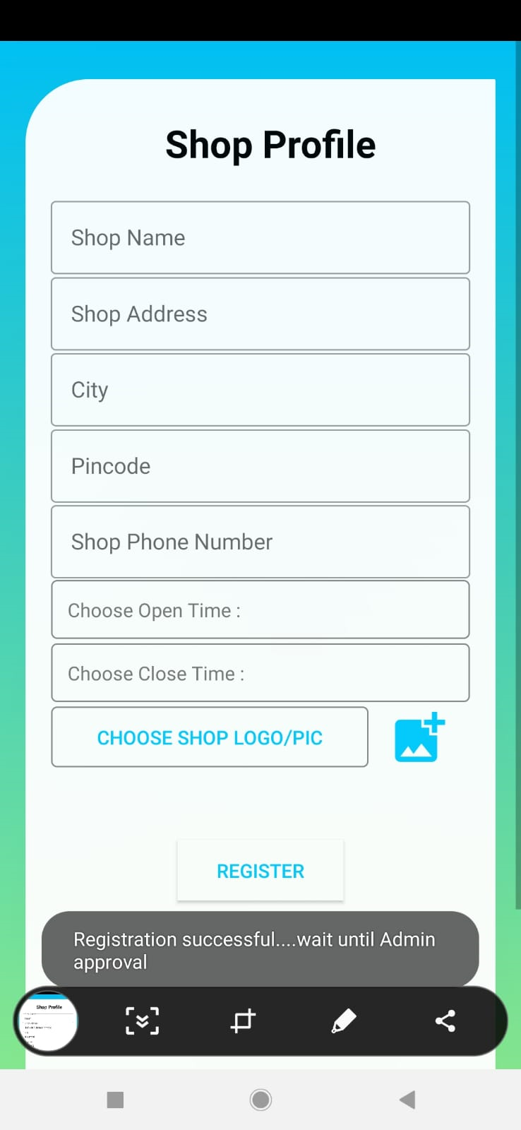
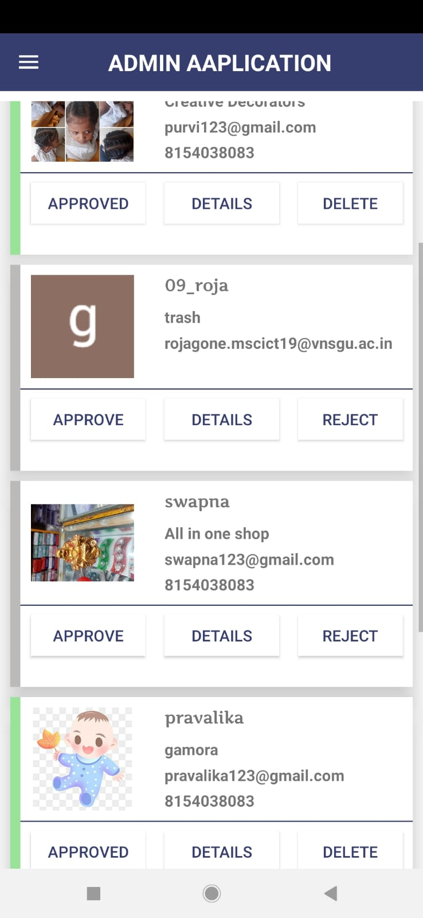

Slide 28
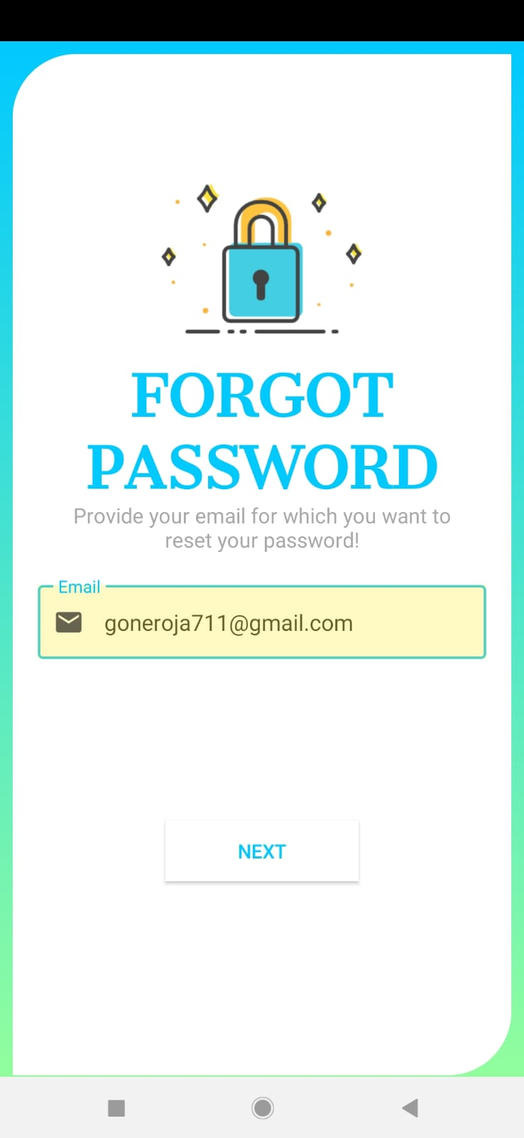
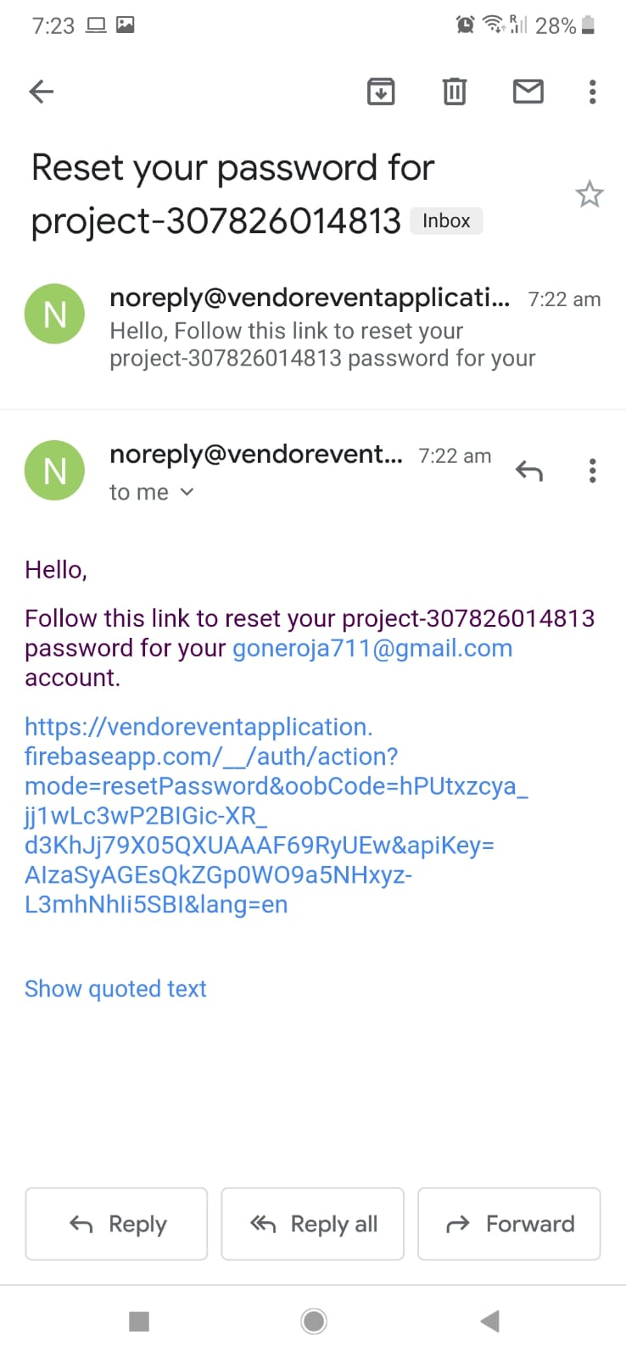

Slide 29
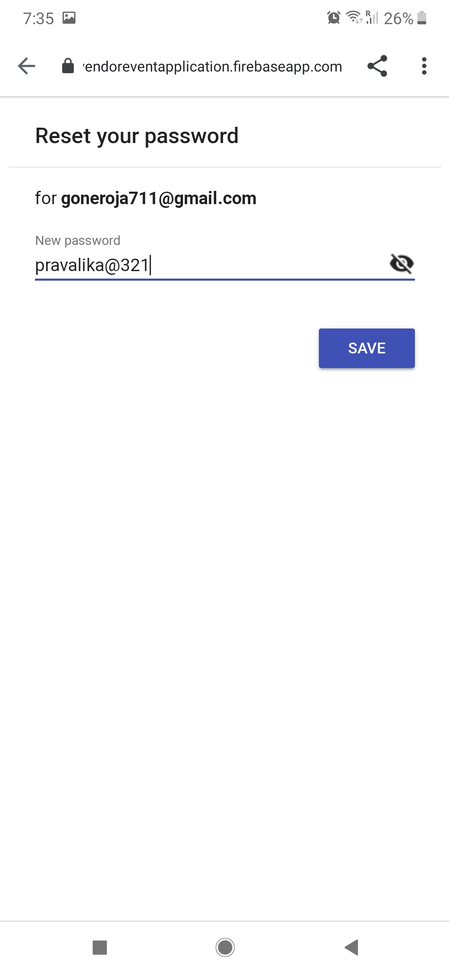
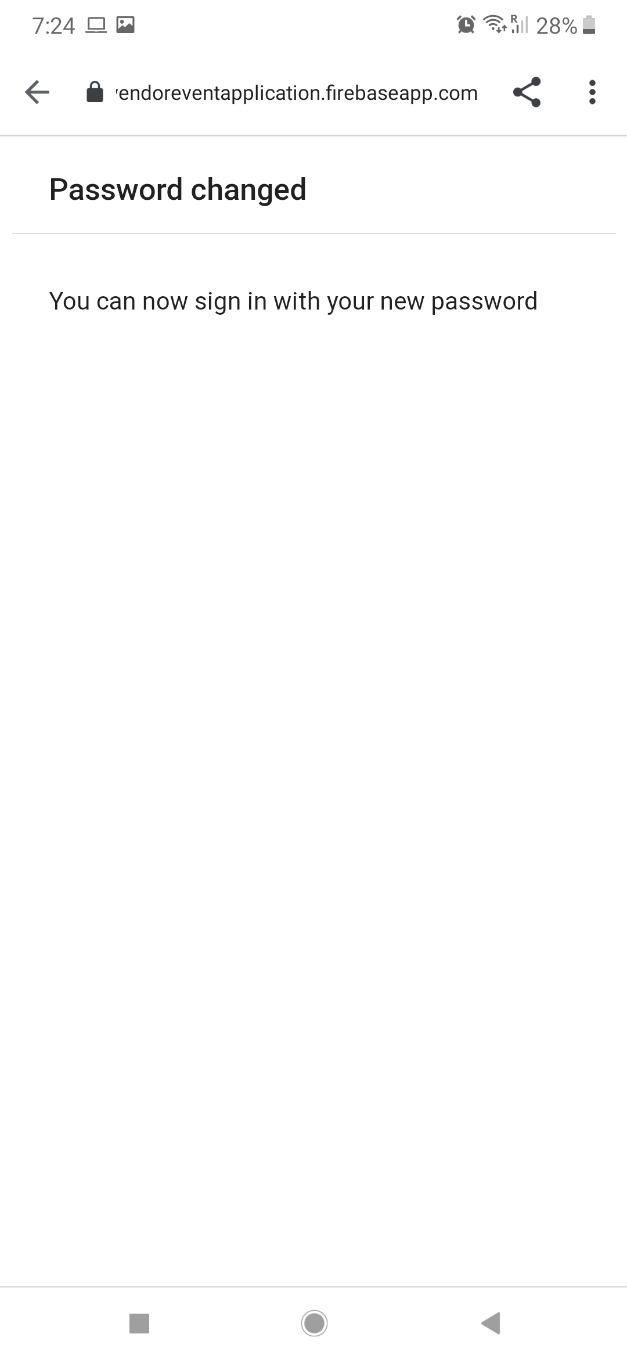

Slide 30

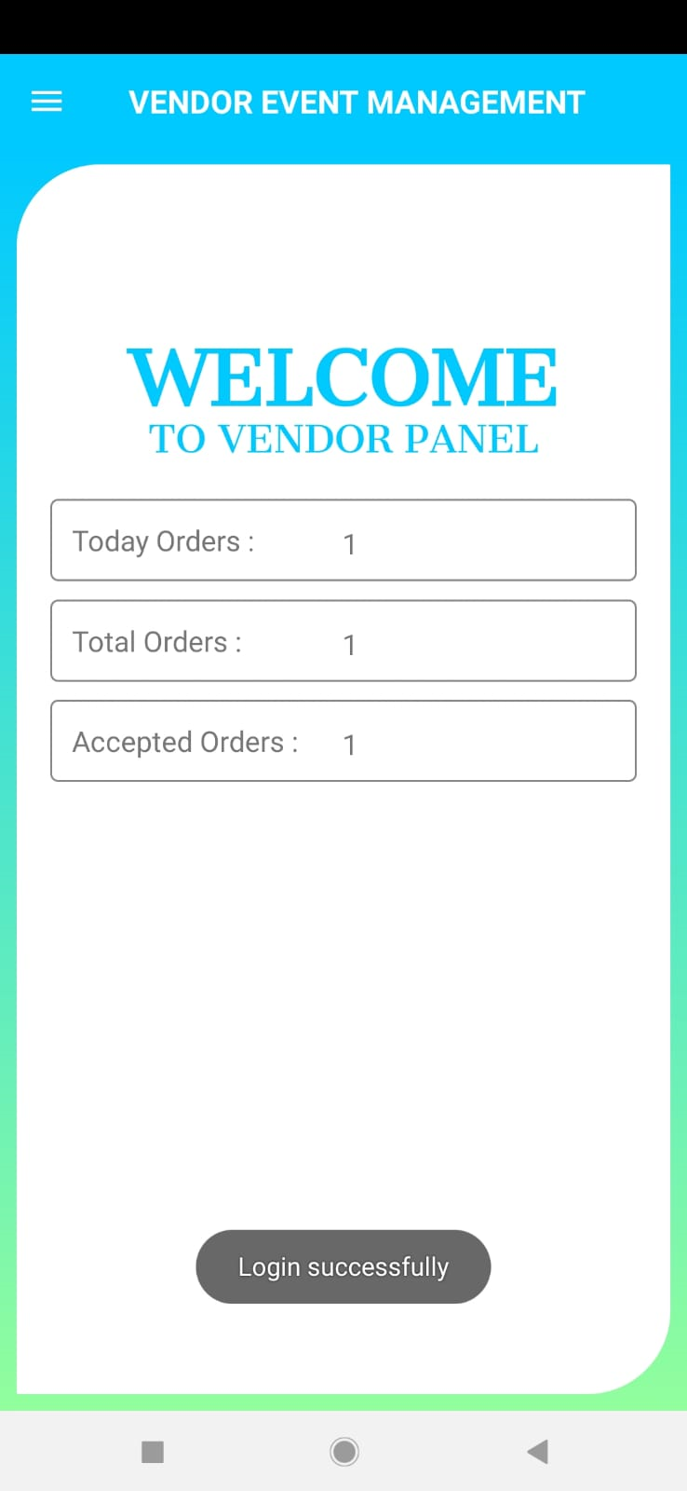

Slide 31

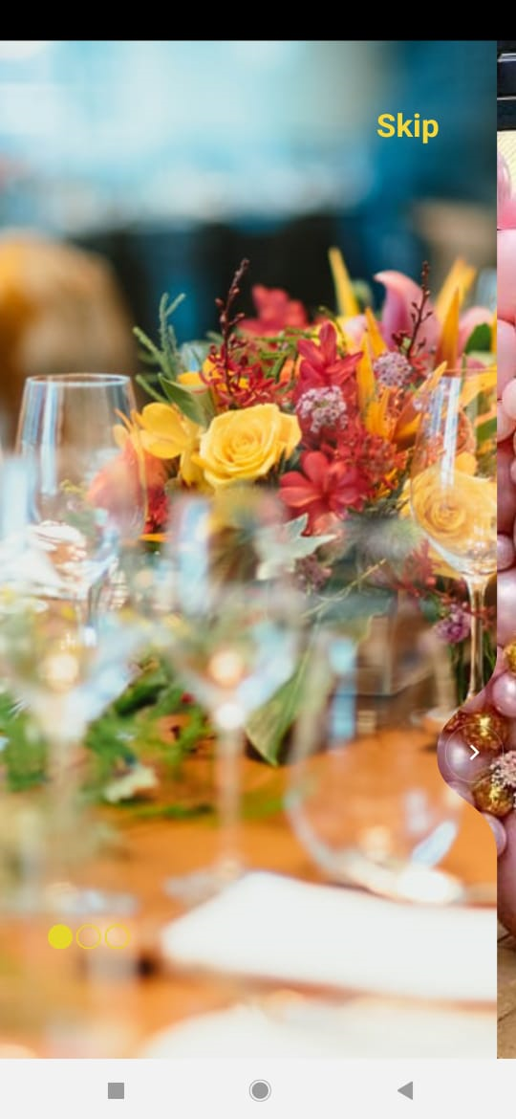

Slide 32

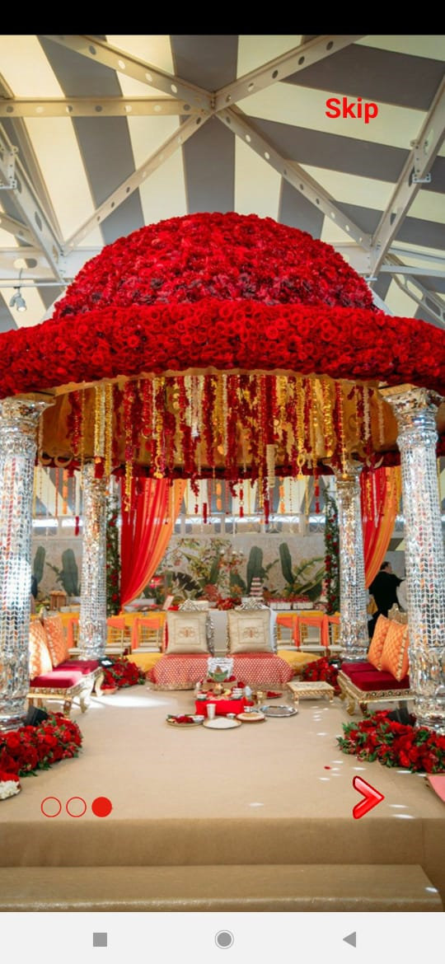

Slide 33
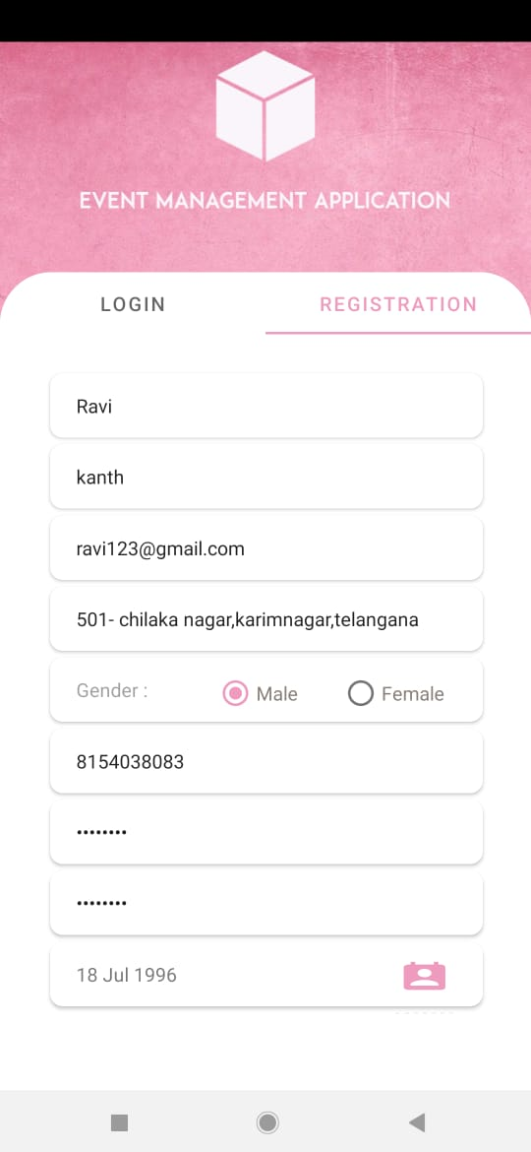
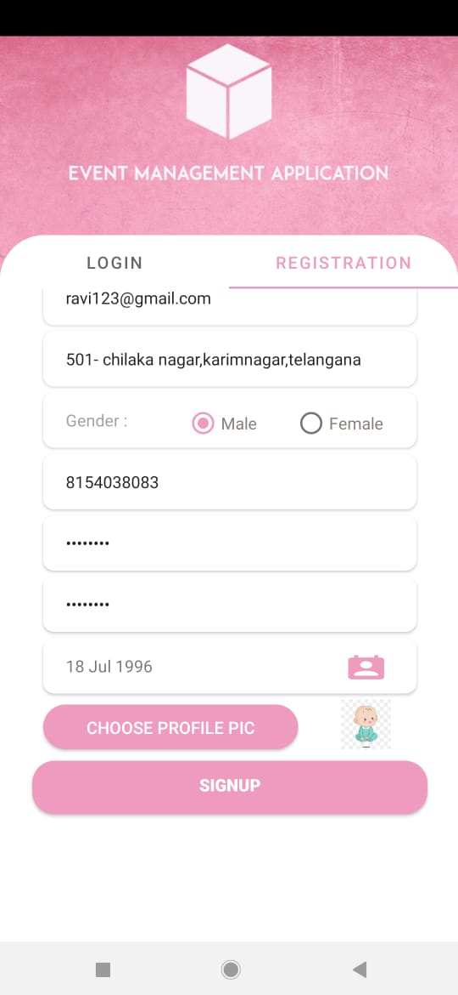

Slide 34
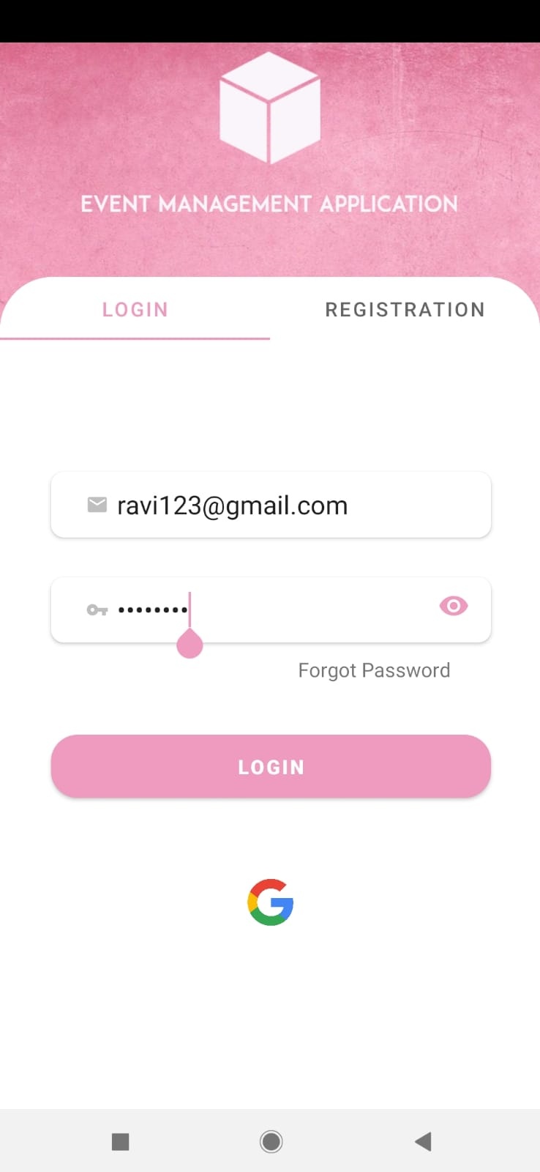
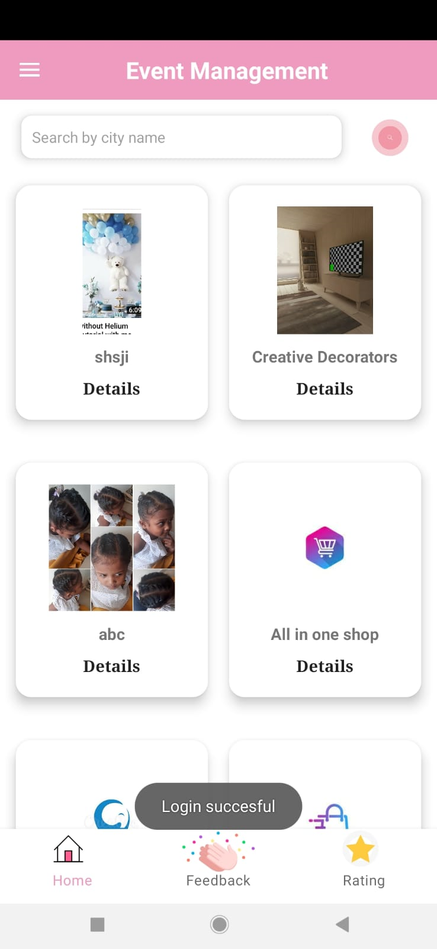

Slide 35
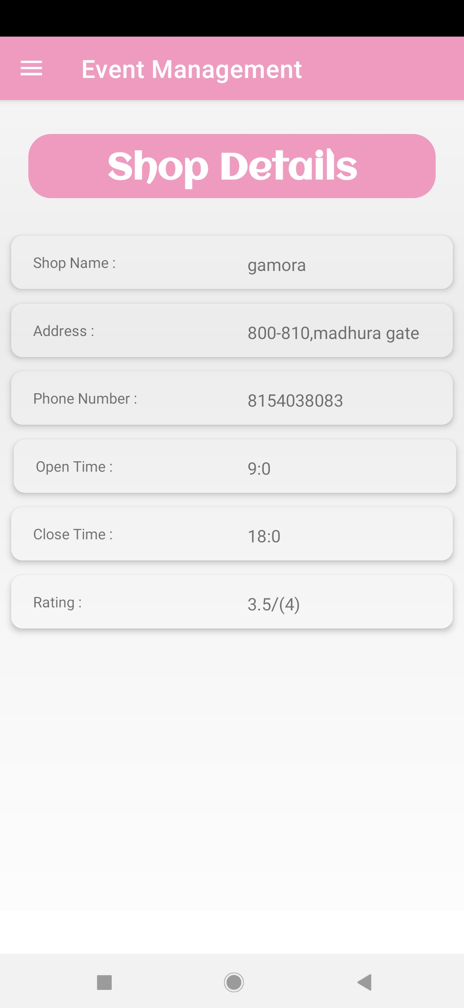
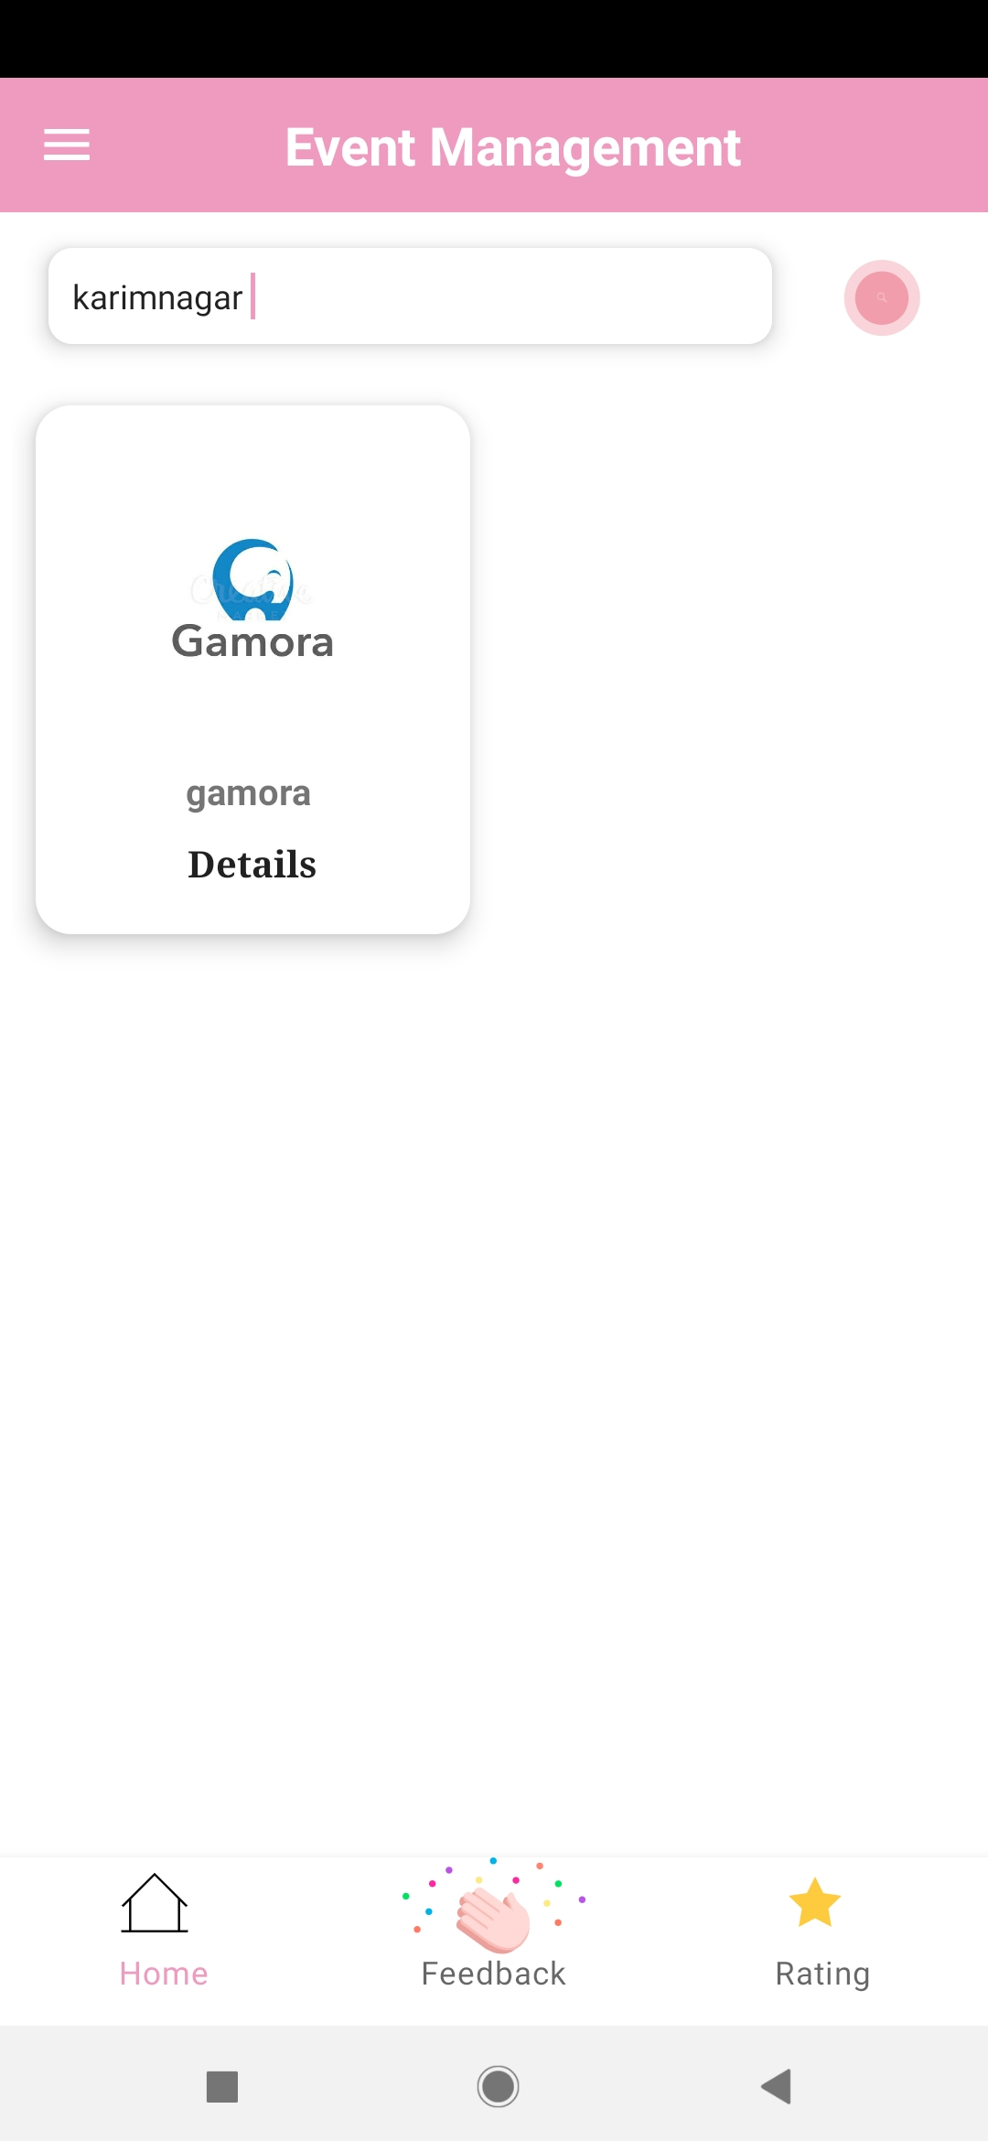

Slide 36
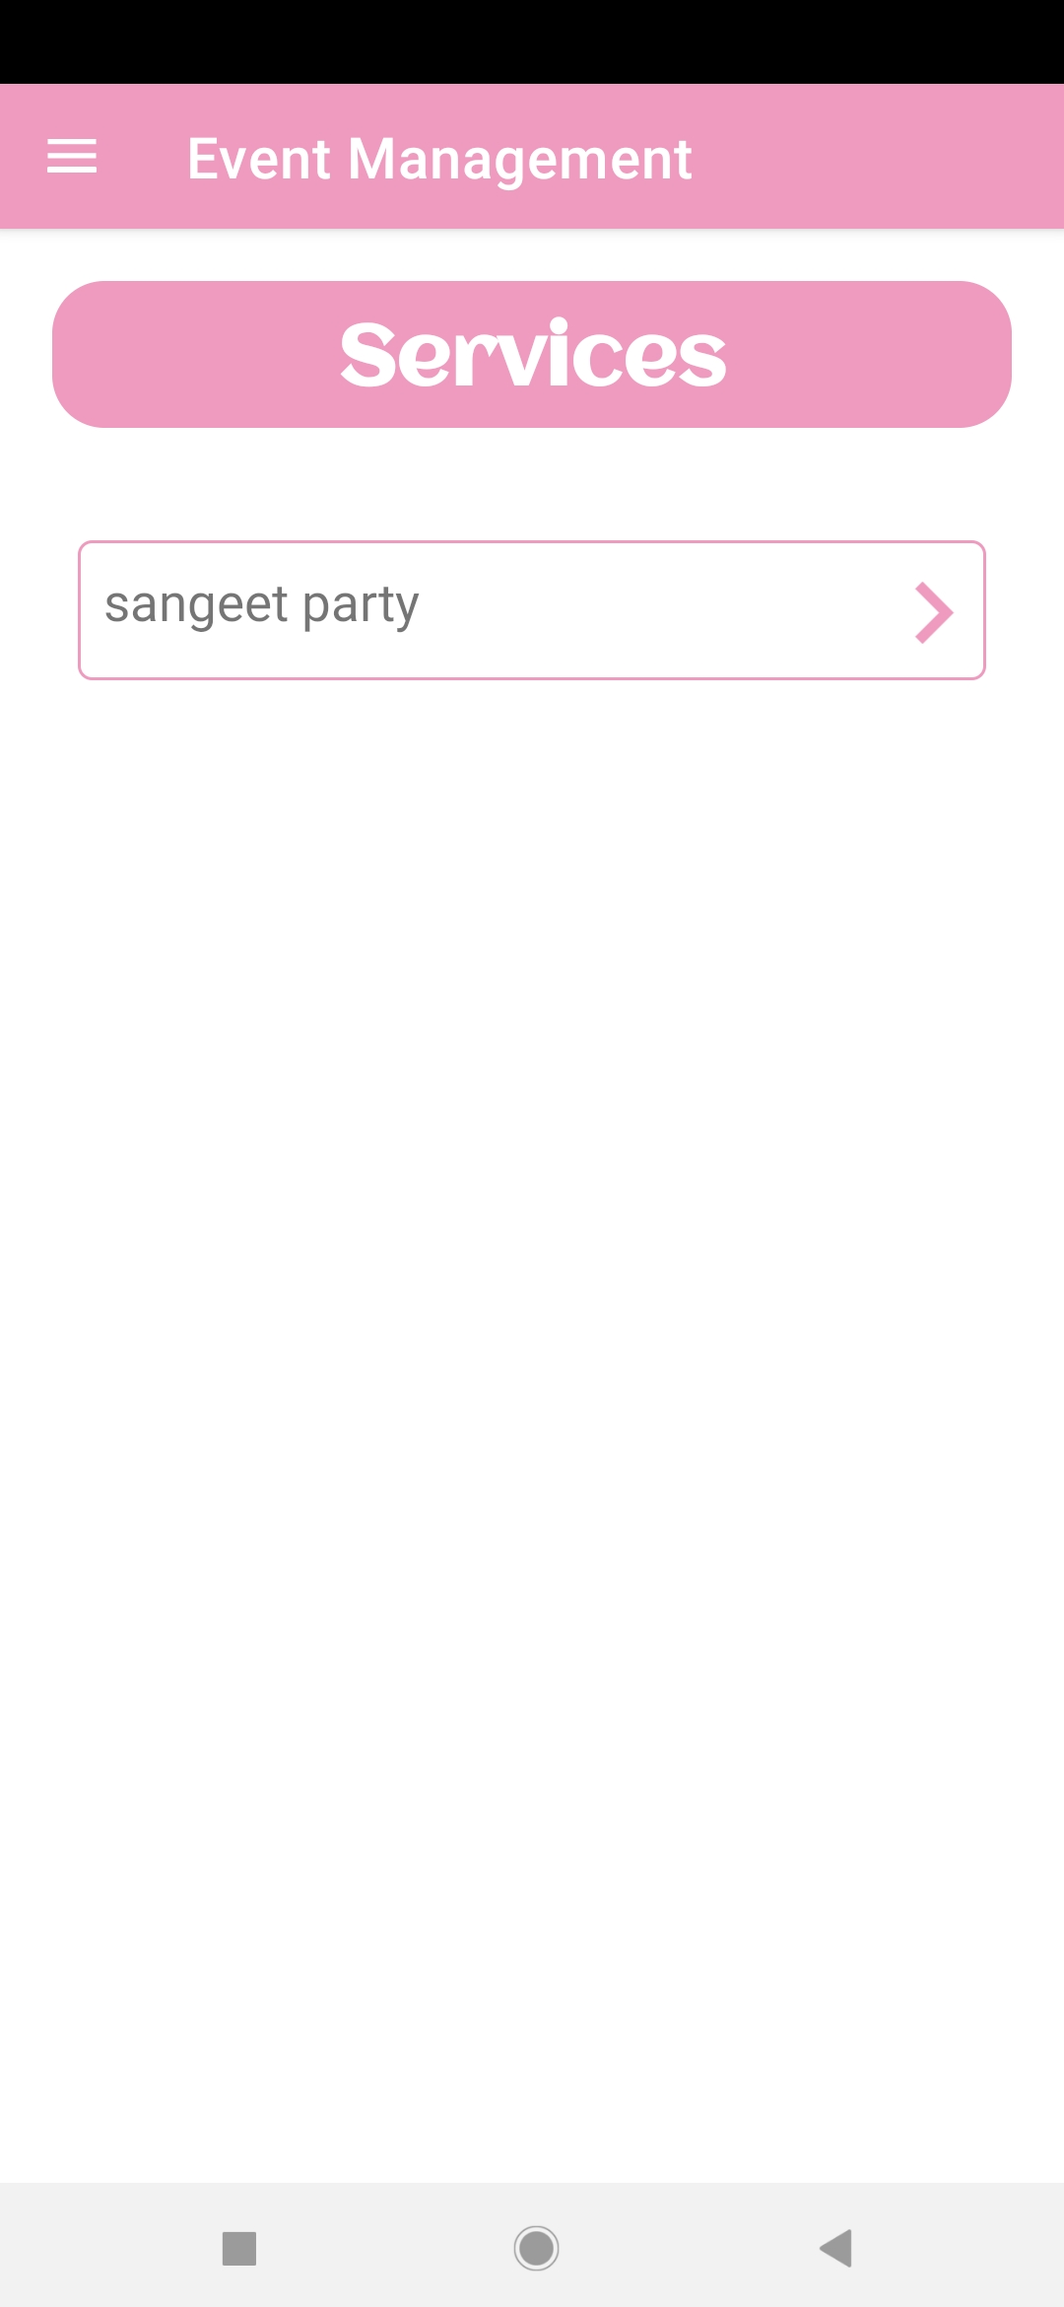
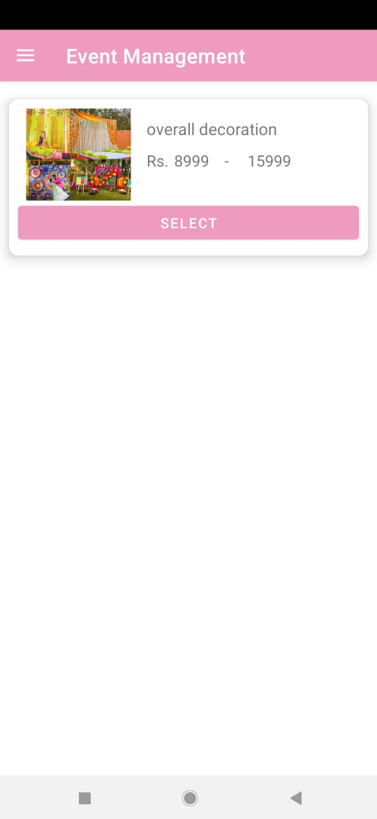

Slide 37



Slide 38



Slide 39



Slide 40



Slide 41



Slide 42



Slide 43


Slide 44
References
https://developer.android.com/guide
https://www.tutorialspoint.com/android/index.htmhttps://www.geeksforgeeks.org/android-tutorial/
https://stackoverflow.com/questions/10196579/algorithm-used-to-calculate-5-star-ratings

